Slide 1
Introduction
Thanks for downloading the SFTool briefing deck! This deck can help you share SFTool with your friends and colleagues.
The slides highlight all the major features of SFTool, but you can just use the ones you need. And don’t hesitate to reach out with any questions!
Thanks,
The SFTool Team
sftool@gsa.gov
Please delete this slide before presenting.

Slide 2
Presented by:
[Name]
[Date]
Notes:
This interactive SFTool session will help you learn how to make sustainable decisions.
GSA’s SFTool.gov helps project managers, facility managers, procurement professionals, and others successfully implement sustainable projects by demonstrating how to form effective teams and empower them to identify and prioritize cost-effective high-performance building and procurement strategies.

Slide 3
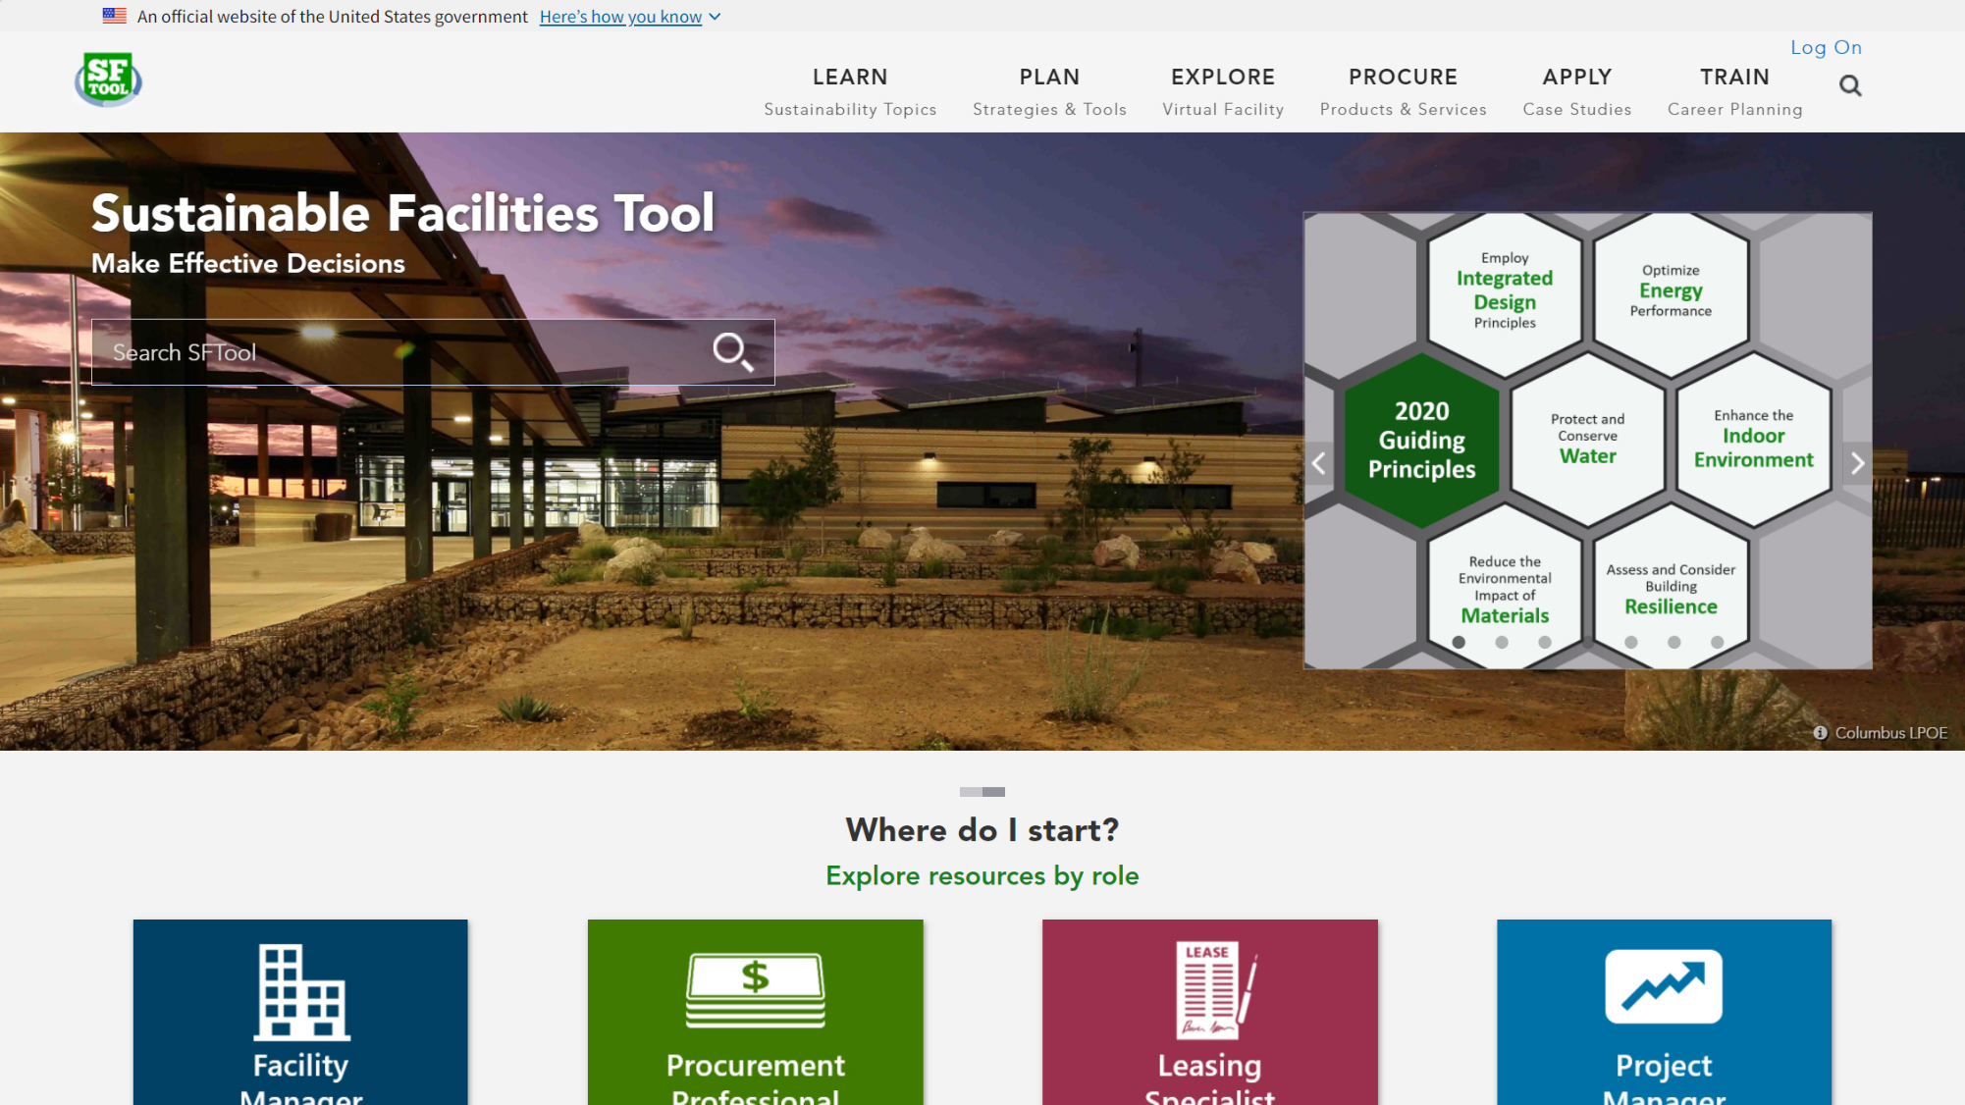
Notes:
This presentation will step through all of the SFTool sections listed on the top menu bar. This will expose you to the complex world of sustainable design, construction, and operations in a succinct and simplified context that allows you to grasp the whole system and learn technical concepts. You will also learn the power of bundling and building integrated teams.
SFTool:
Identifies cost-effective sustainable building and procurement strategies to improve environmental performance and occupant health.
Models an inclusive approach to sustainable practices that moves beyond large mechanical systems & expert-led construction projects.
Clarifies the relationship between sustainability guidance and the physical, financial and human resources we seek to conserve.
Engages and empowers people to ask questions, persuade others and make informed decisions -- regardless of previous knowledge level or role.

Slide 4
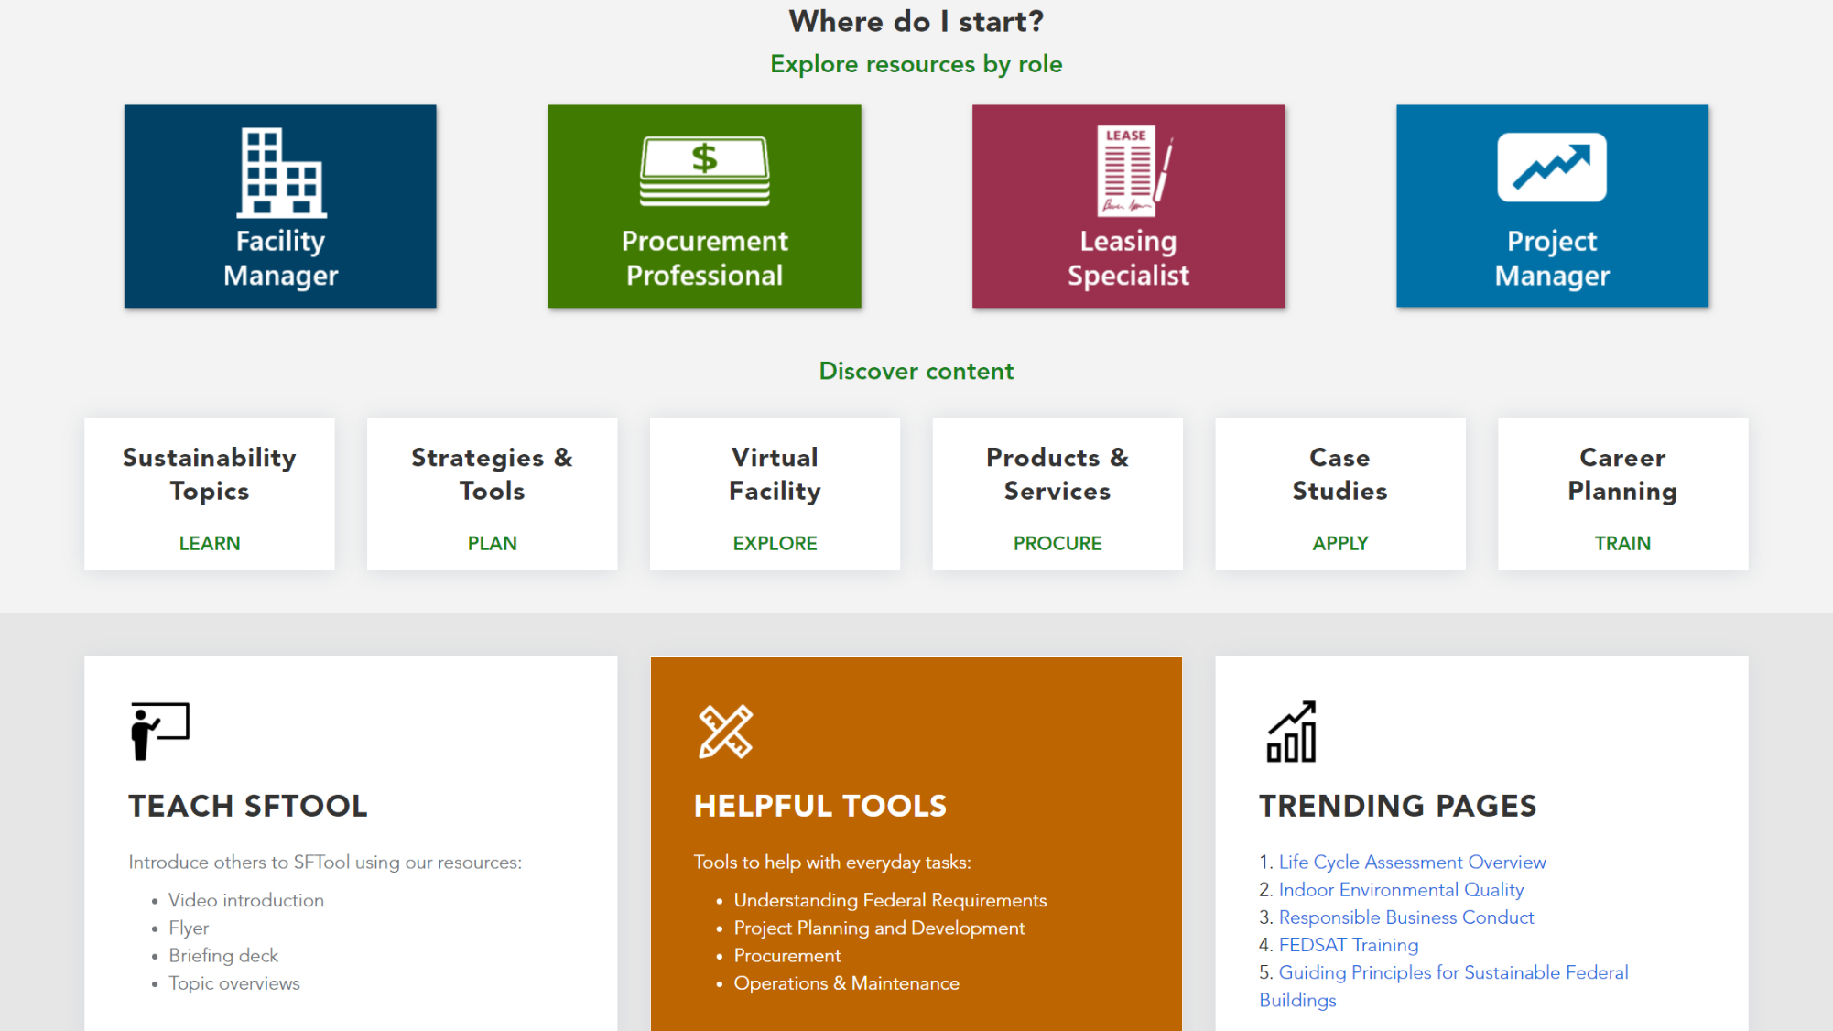
Notes:
To start, scrolling down the homepage will show links to more resources. If you click on the Teach SFTool box...

Slide 5
Notes:
You’ll find a page where you can watch a video introduction and download resources, including the template for this briefing!

Slide 6
Notes:
From the homepage, you can also access User Guides for various project team members.

Slide 7
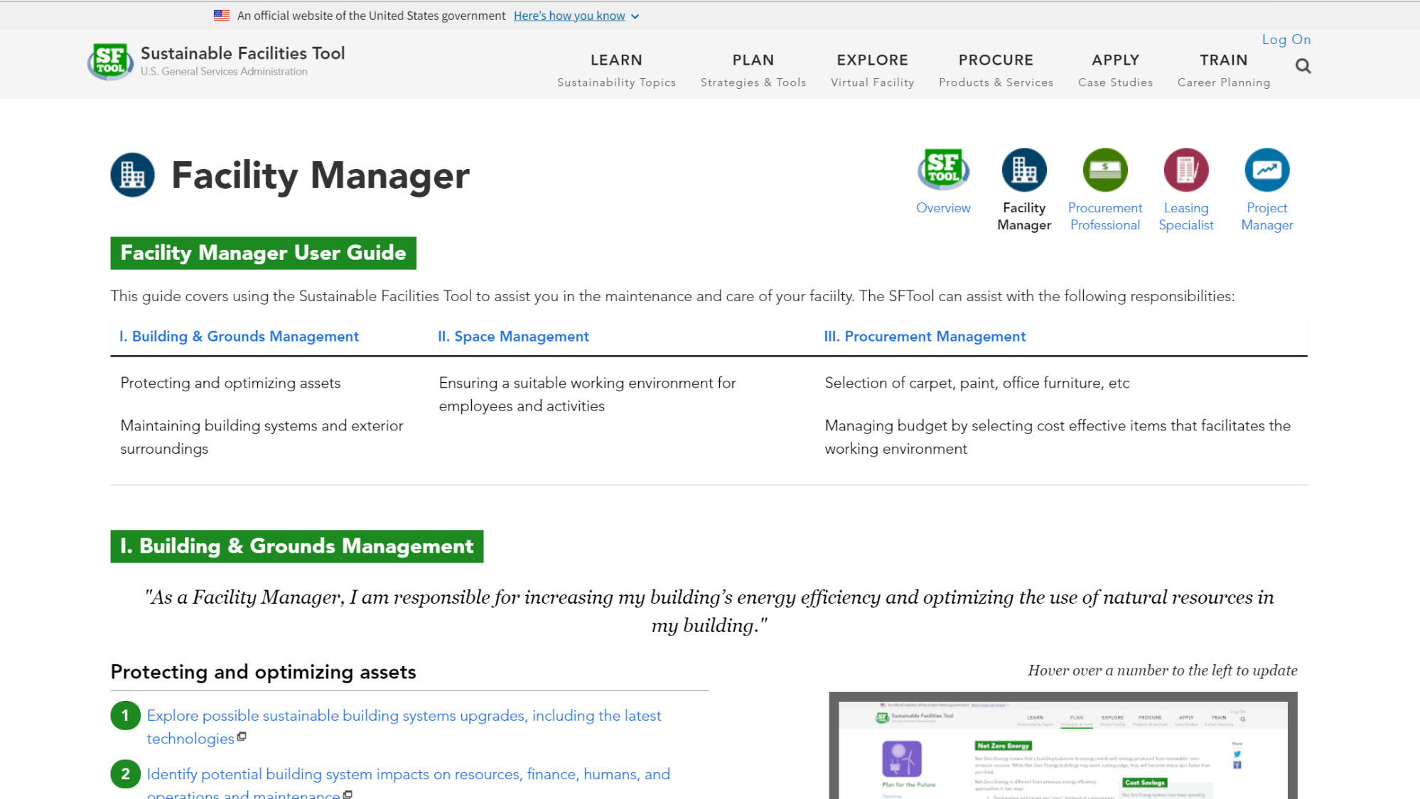
Notes:
Each User Guide walks users through the SFTool features and resources that can assist with their project responsibilities.

Slide 8
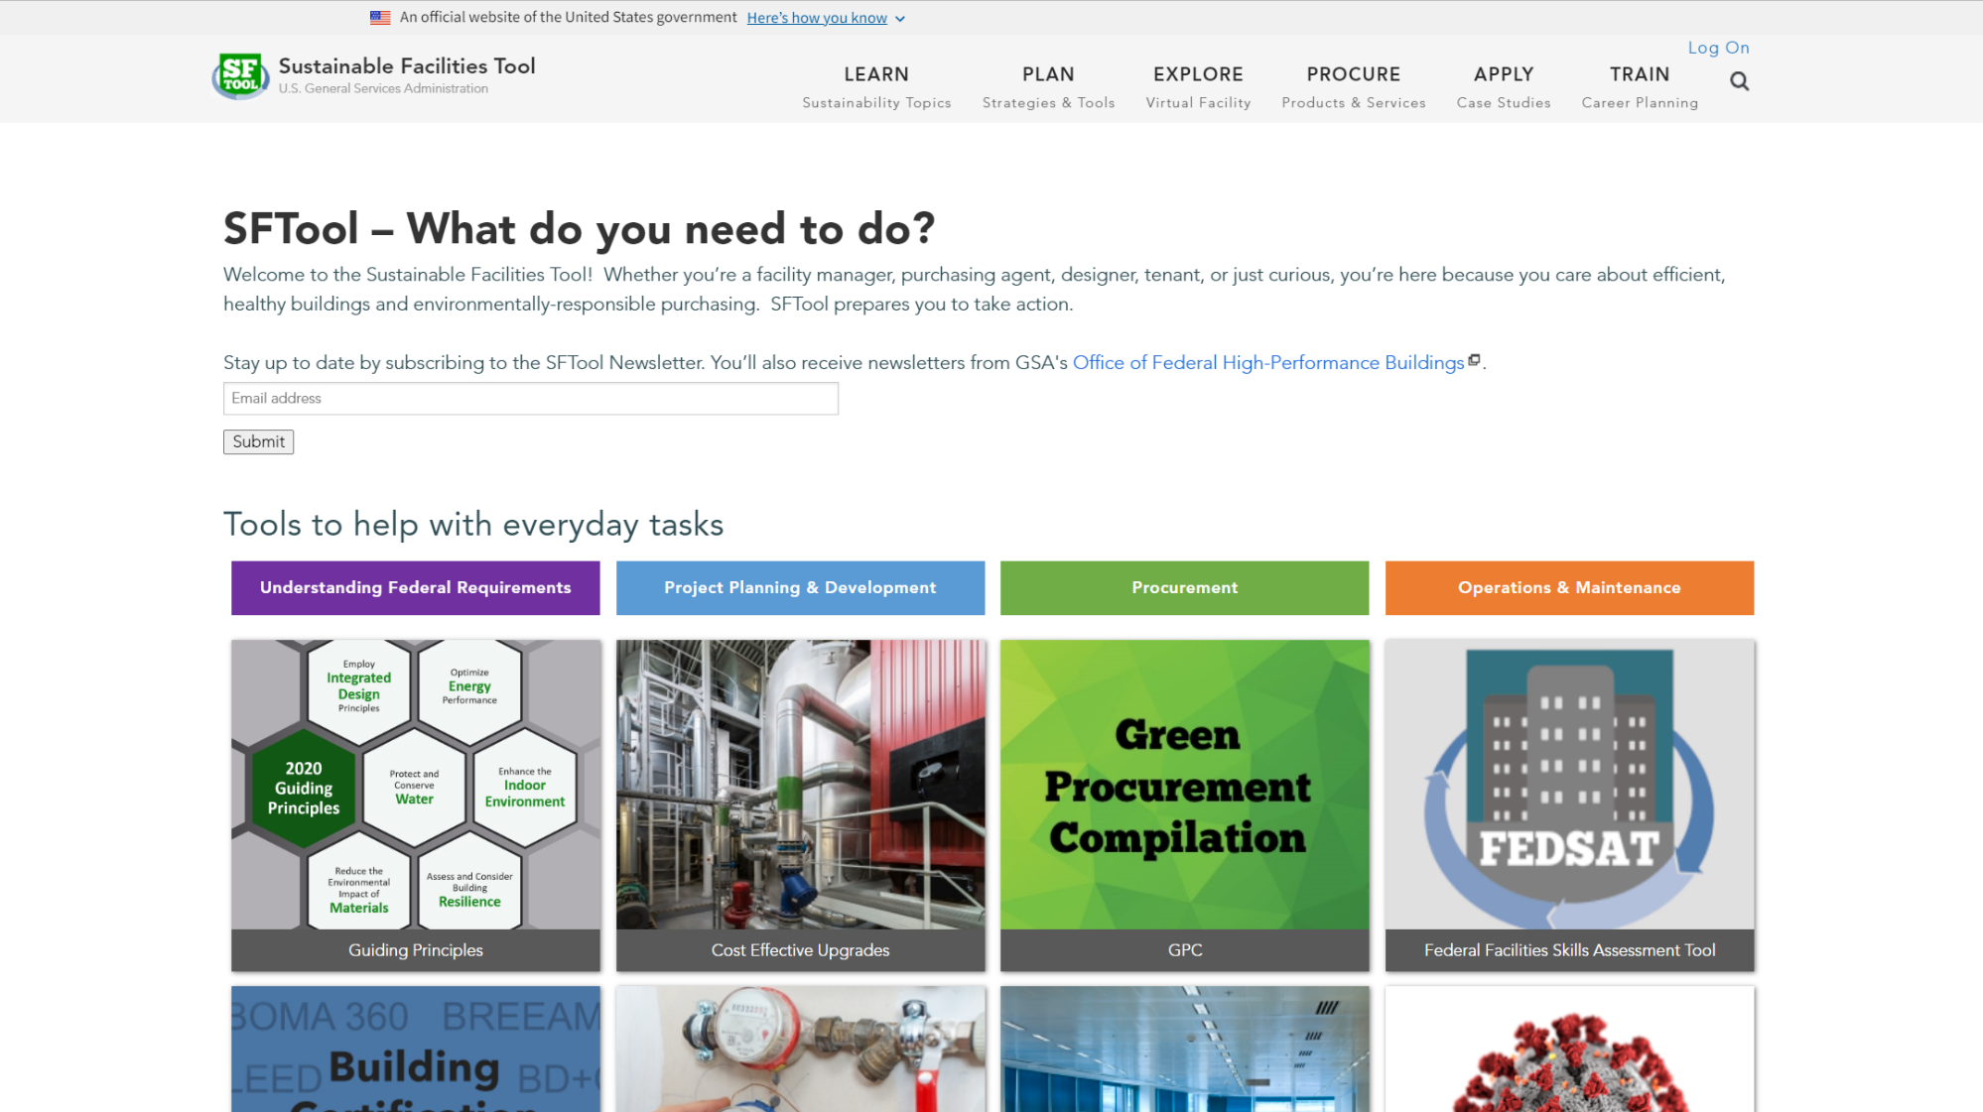
Notes:
If you want to quickly find the major tools, visit the Helpful Tools page. Otherwise, you can start by exploring each section using the top tabs…

Slide 9
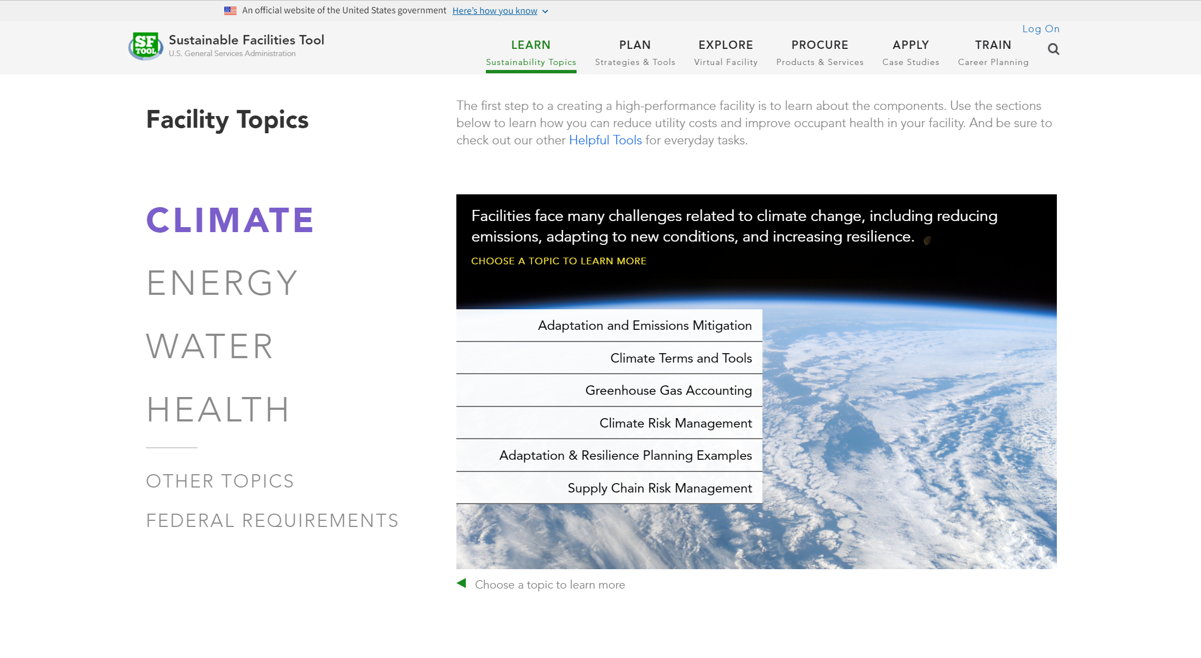
Notes:
In the Learn section, you can read descriptions, tips, and case studies about everything from water efficiency to plug load reduction. You can also view legislation and understand the impact of policy on sustainability.

Slide 10
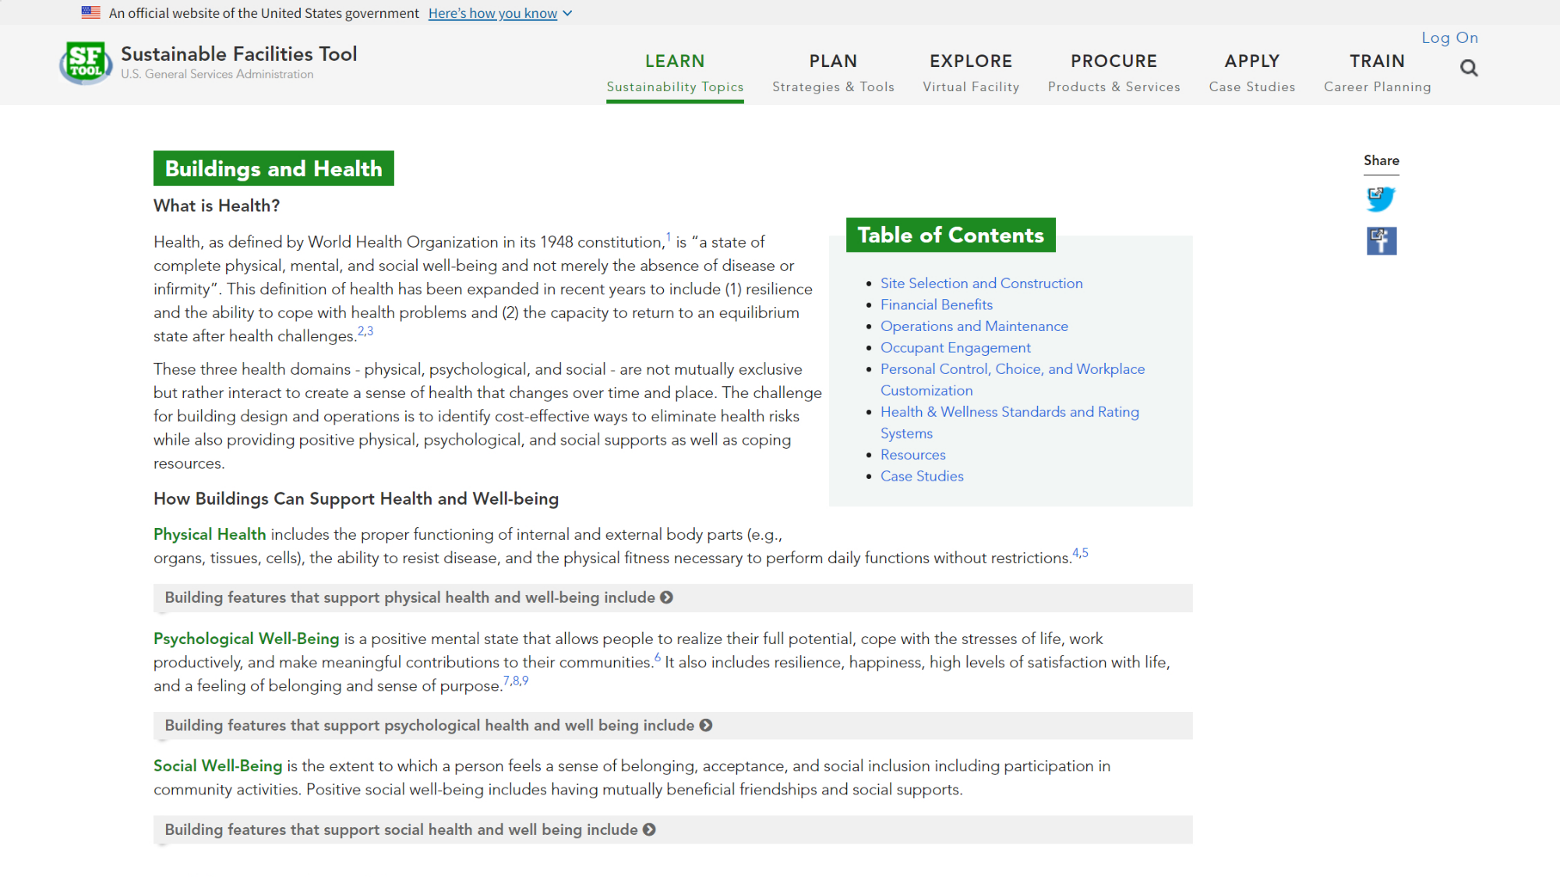
Notes:
On the Buildings and Health page, you can learn about almost every aspect of health and wellness in buildings. The page is full of links to related SFTool content and external resources.

Slide 11
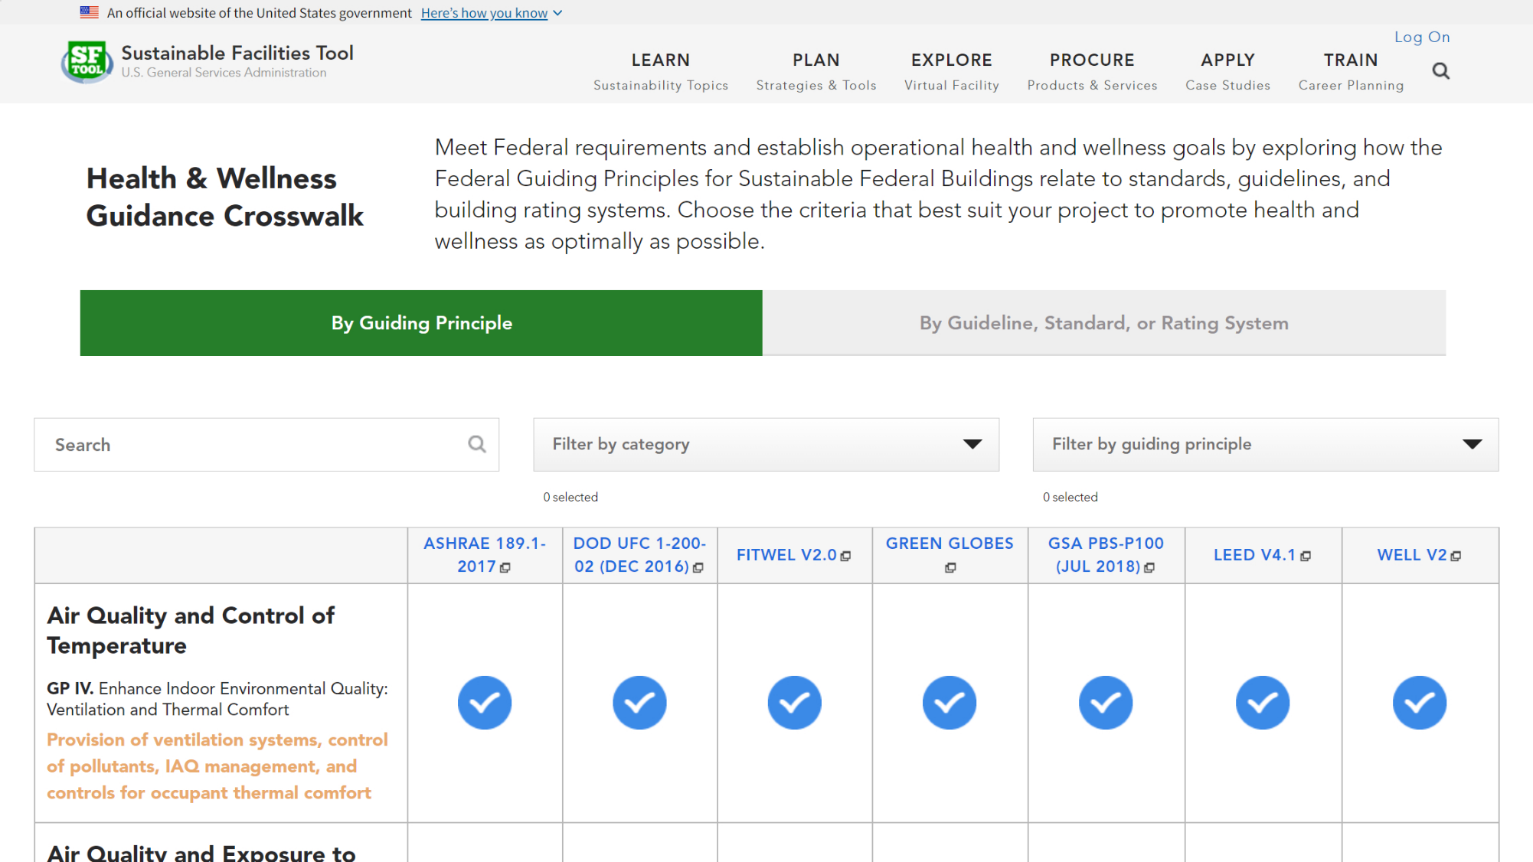
Notes:
The Buildings and Health page includes a link to the Health & Wellness Crosswalk, which allows you to explore how various guidelines, standards, and rating systems address the health topics in the federal Guiding Principles.

Slide 12
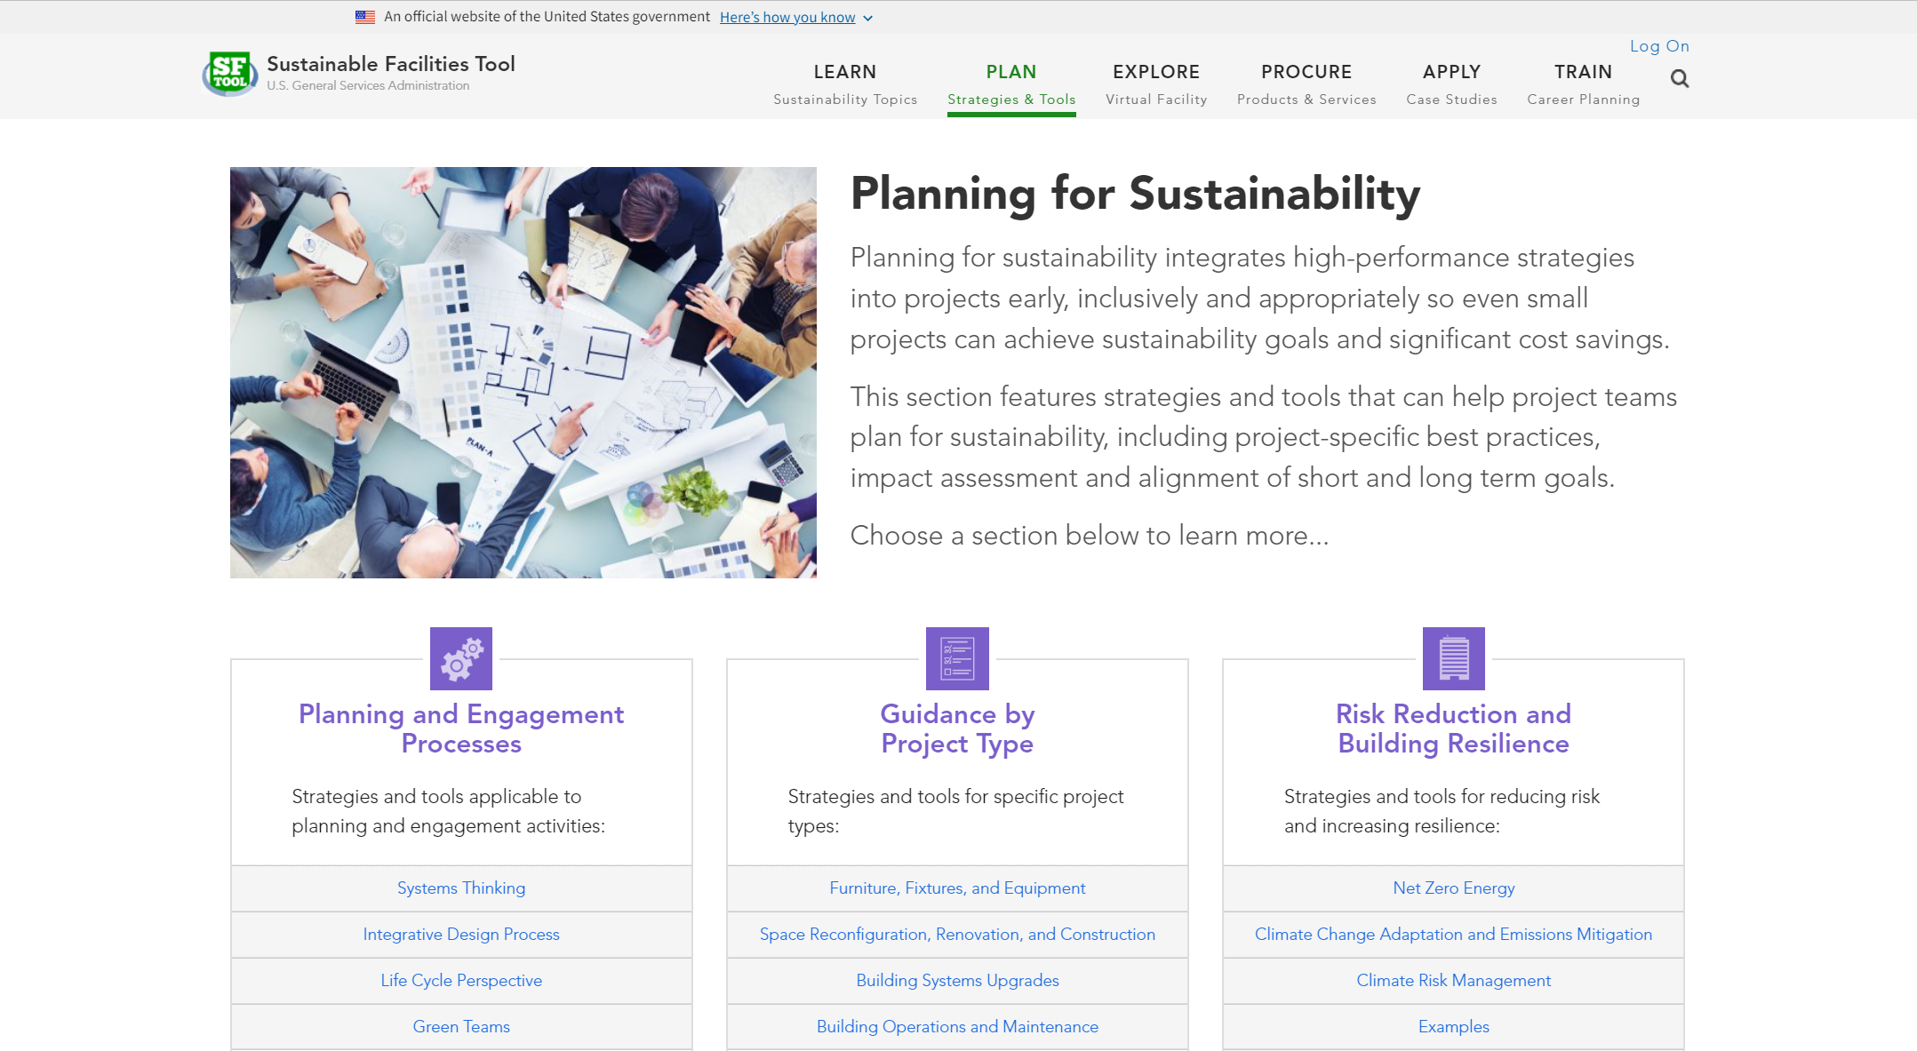
Notes:
Visit the Plan section to get strategies for building sustainably or turning an existing space into a healthier environment. Try approaches that look at material lifecycles, help your building use clean energy or establish a solid waste reduction plan. Make sure you’re preparing for the long term impacts of climate change.

Slide 13
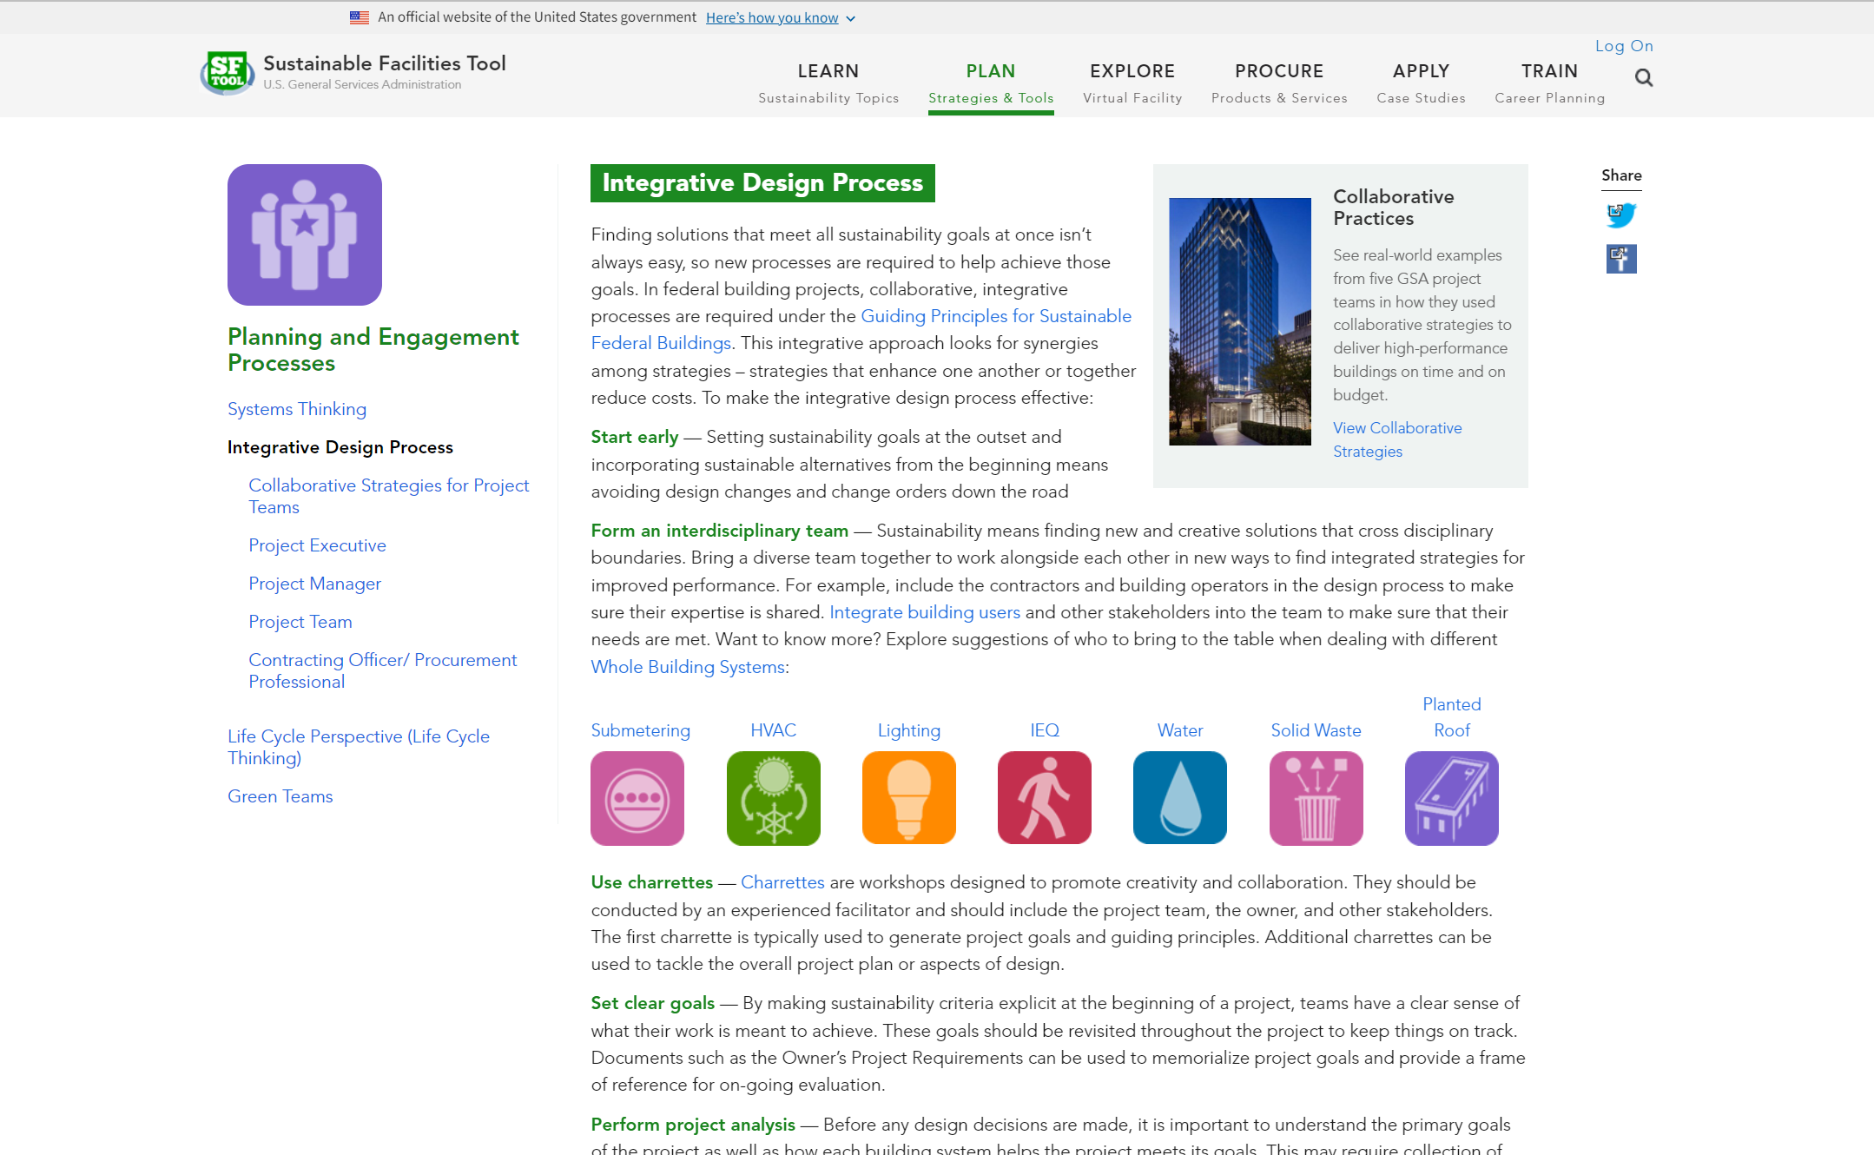
Notes:
A major theme in SFTool is integrative design. In the Plan section, you can learn how to build an interdisciplinary team and apply the integrative design process to your projects.

Slide 14
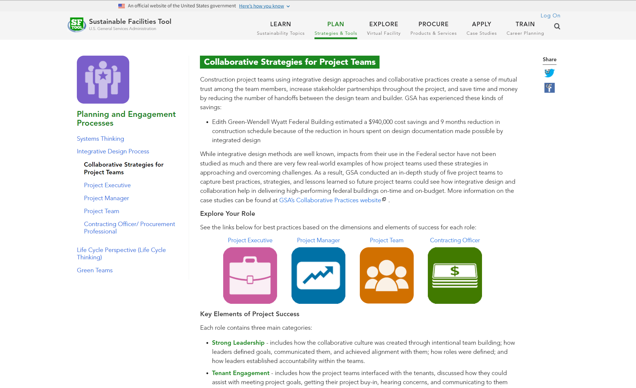
Notes:
This section includes collaborative strategies from GSA projects that you can apply to your own role.

Slide 15
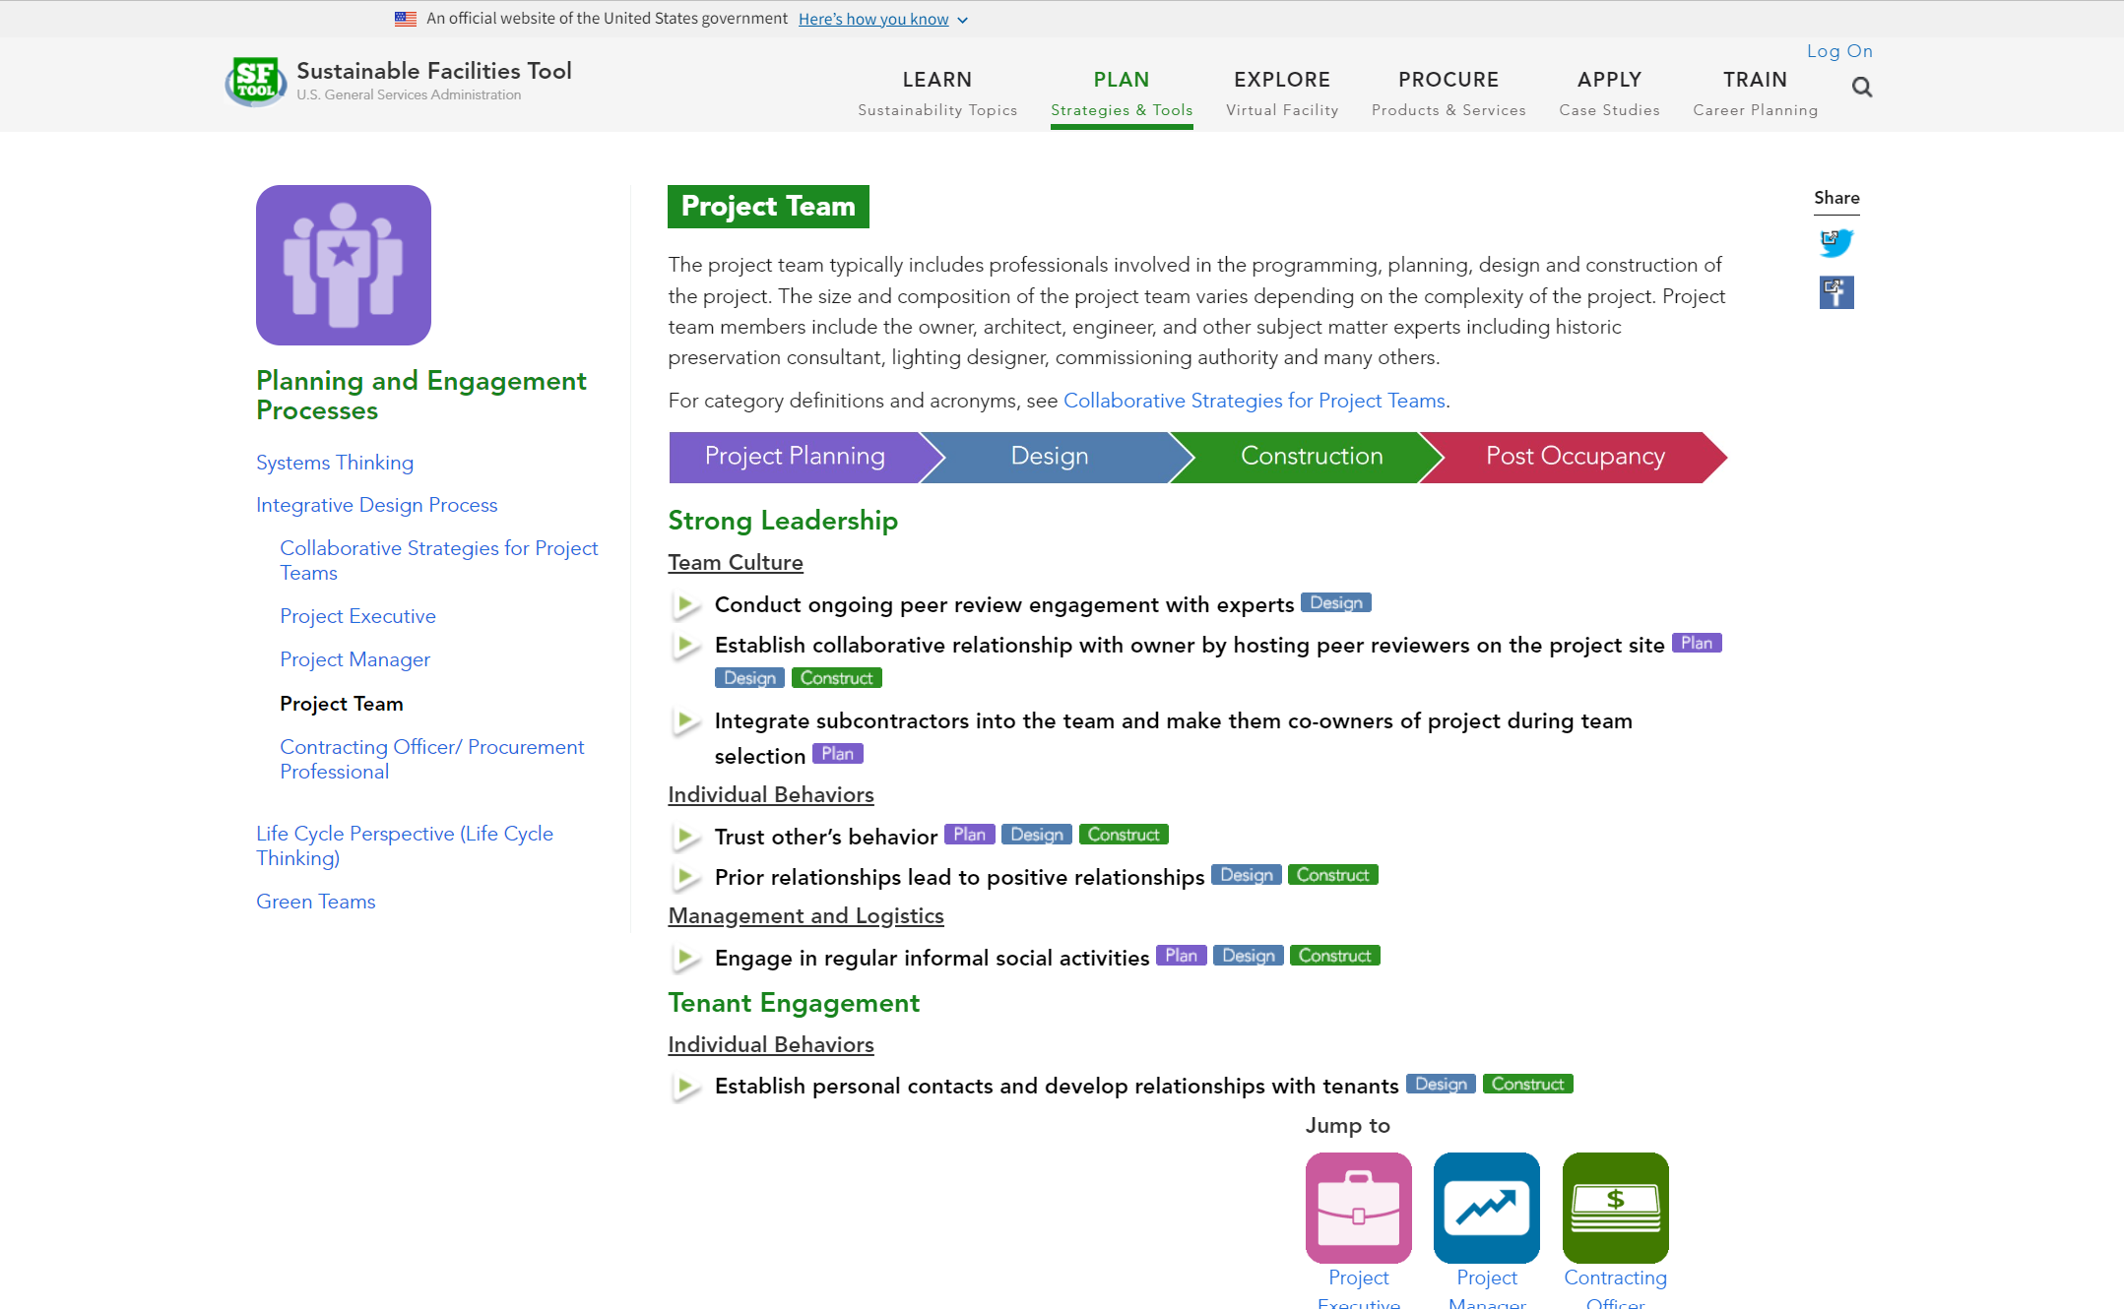
Notes:
Within each role, you can explore strategies by topic or use the color tags to view all strategies for a particular project phase.

Slide 16
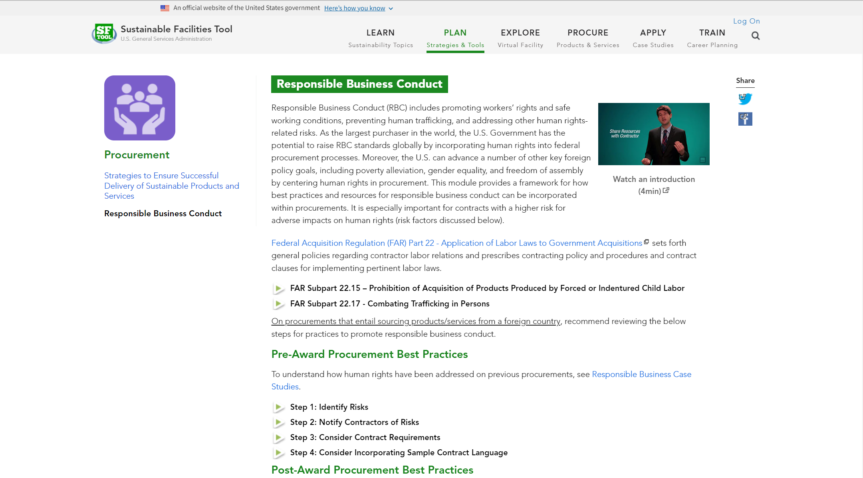
Notes:
The Responsible Business Conduct module provides a framework for how best practices and resources for responsible business conduct can be incorporated within your procurements.

Slide 17
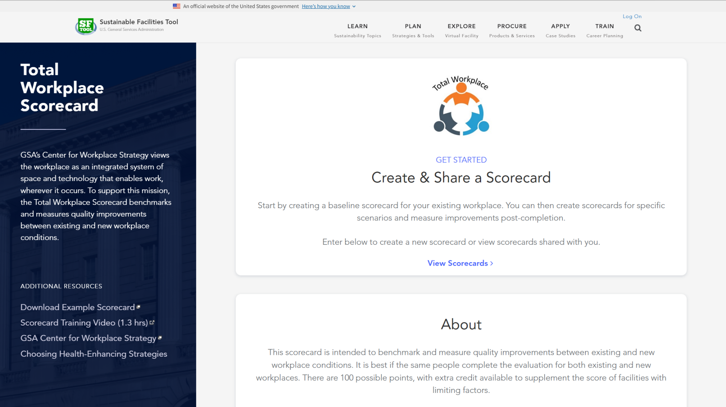
Notes:
The Total Workplace Scorecard allows you to benchmark and measure improvements to workplace conditions. To get started, click “View Scorecards” and log in.

Slide 18
Notes:
From the main menu, you can create and manage your scorecards. Start by going to “Create new scorecard”.

Slide 19
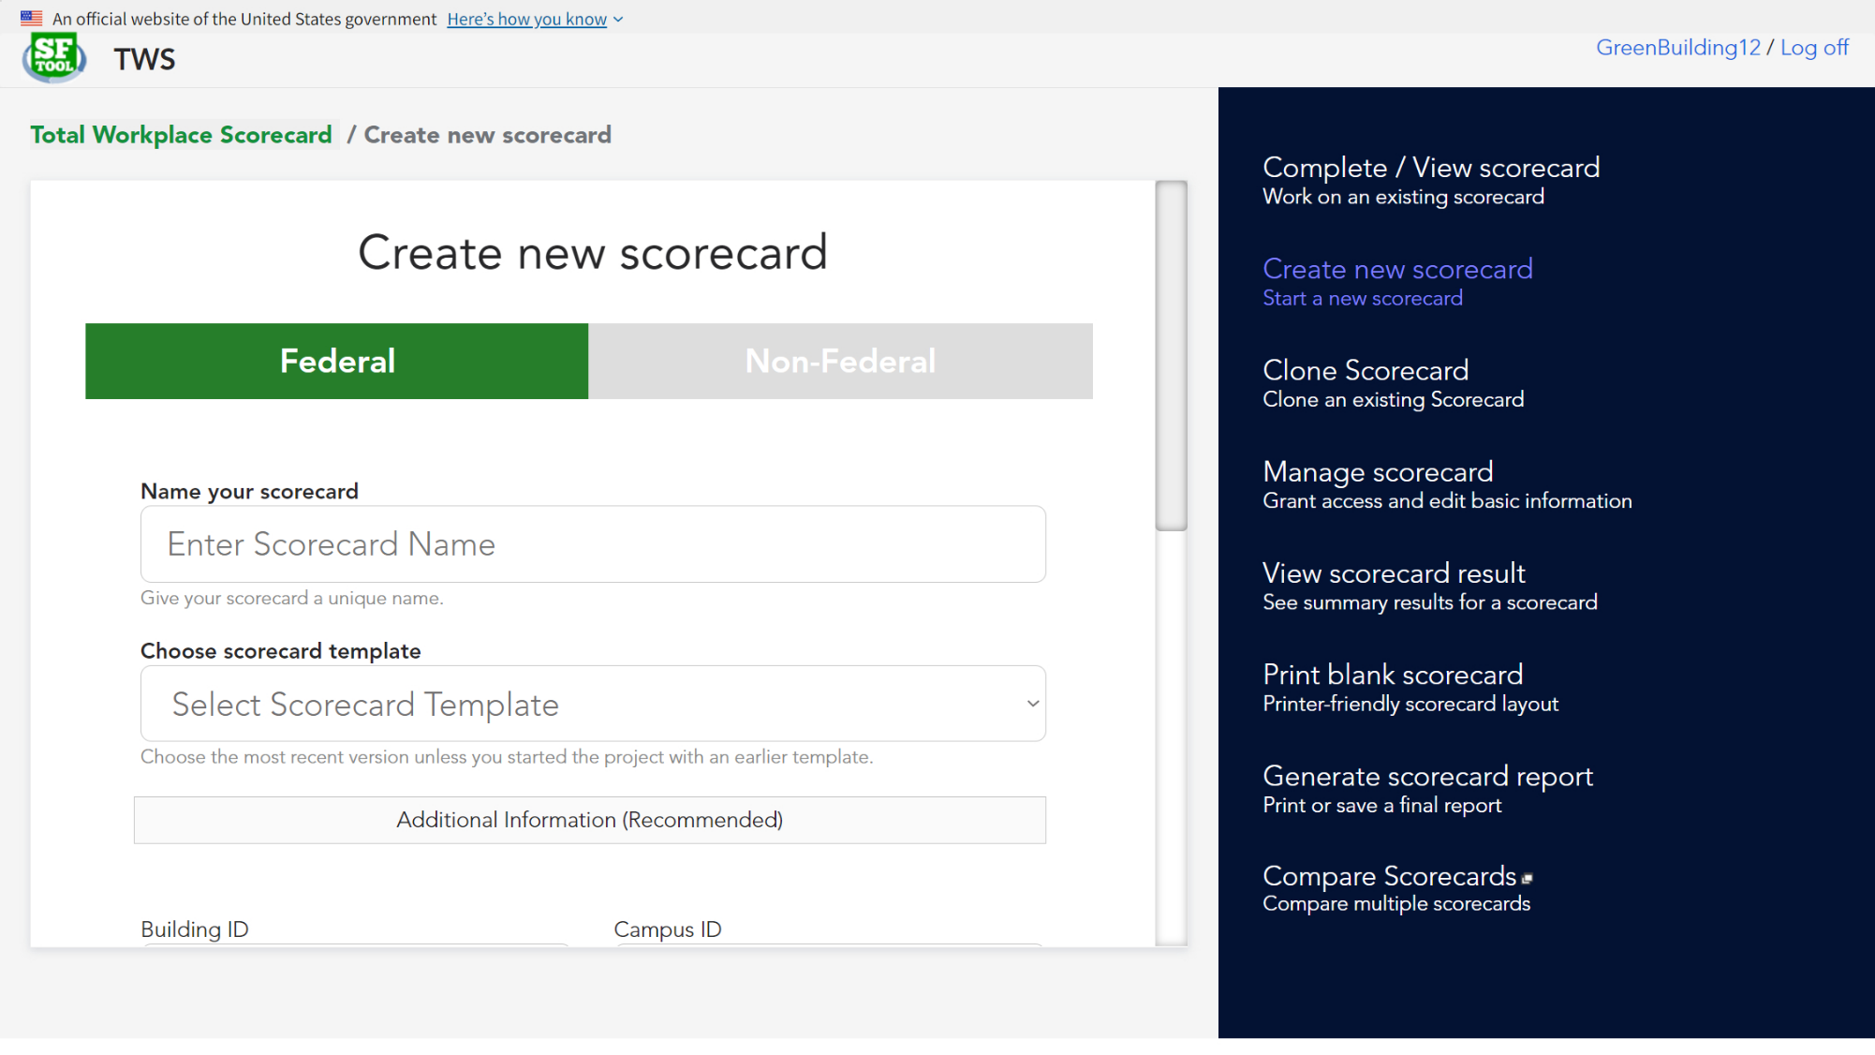
Notes:
Choose whether it’s a federal or non-federal building, create a name, and select a template for either a whole or partial scorecard. You can also provide optional building information.

Slide 20
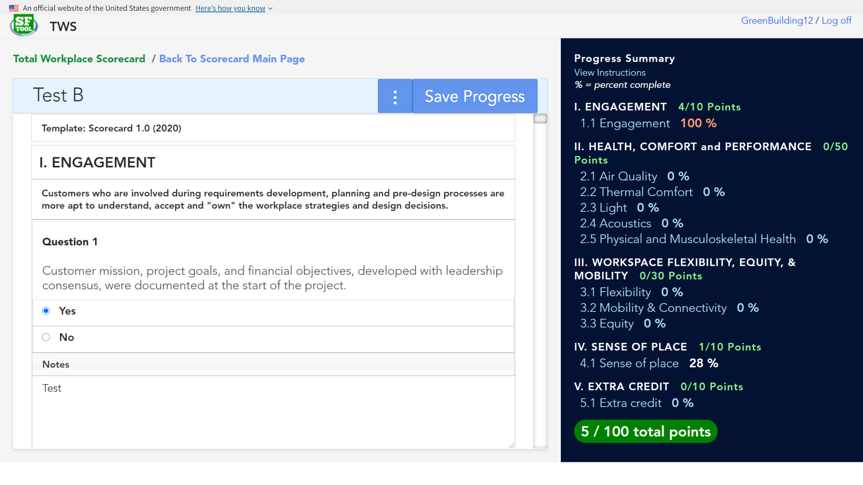
Notes:
You’ll then be able to start completing the scorecard. Select answers, add notes, and upload photo evidence when needed. Some questions will also provide additional instructions in a dropdown. Save your progress frequently to update the score.

Slide 21
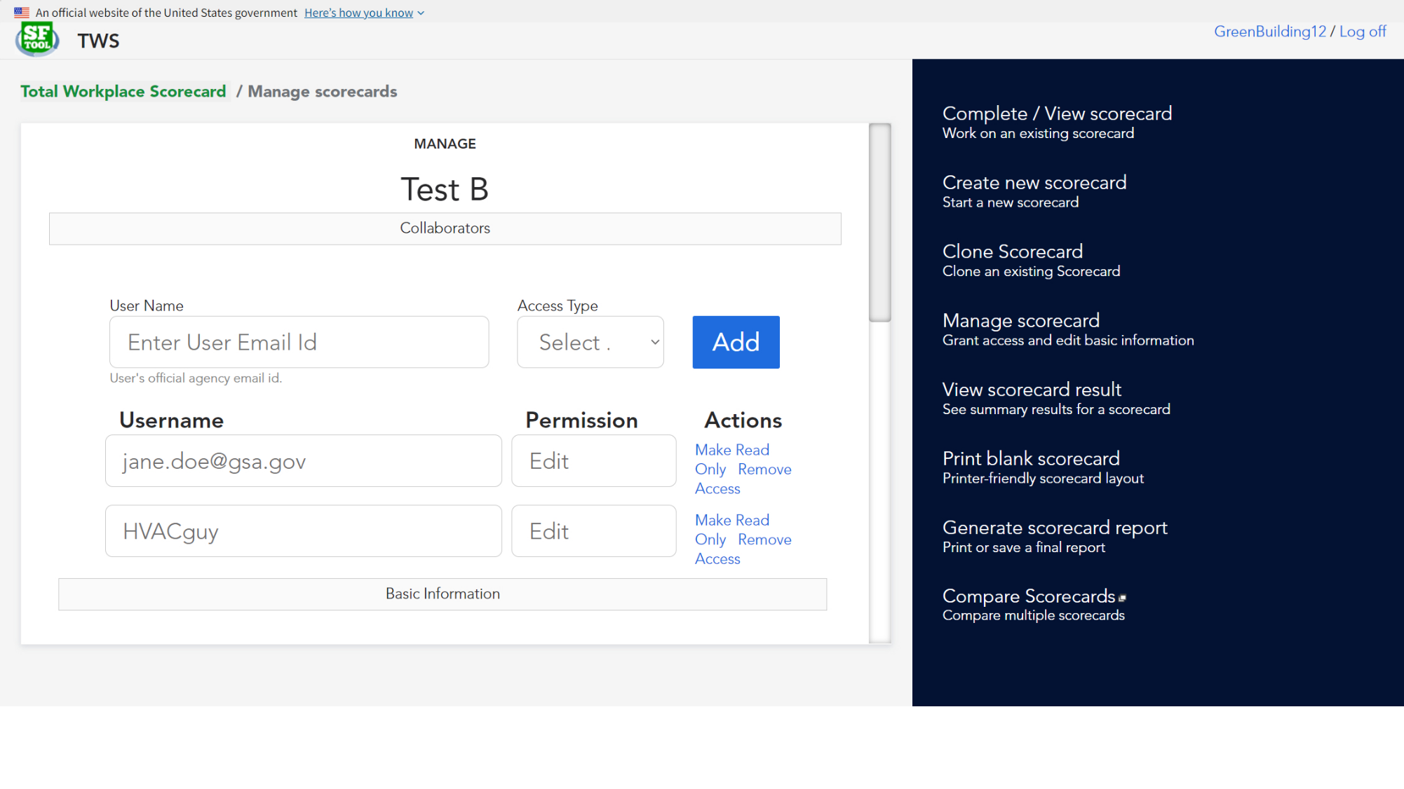
Notes:
Since the scorecard covers a wide variety of topics, you may want help. From the top of a scorecard or the main menu, you can manage access to your scorecards. This feature allows you to invite others to view or edit the scorecard, as well as edit the basic building information.

Slide 22
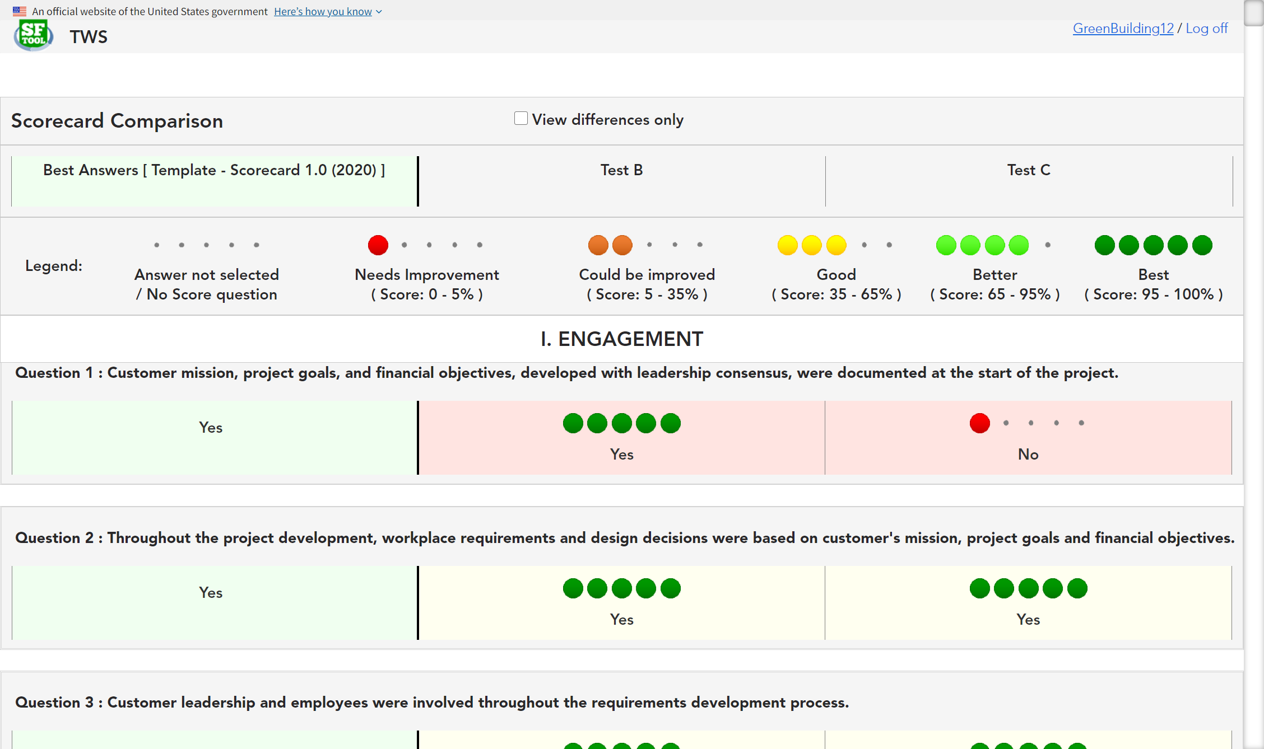
Notes:
You can also compare scorecards to see how much you’ve improved or to run scenarios. The first column will always show the best answer for reference. Different answers are color coded for quick references, with a filter at the top to just show differences only.

Slide 23
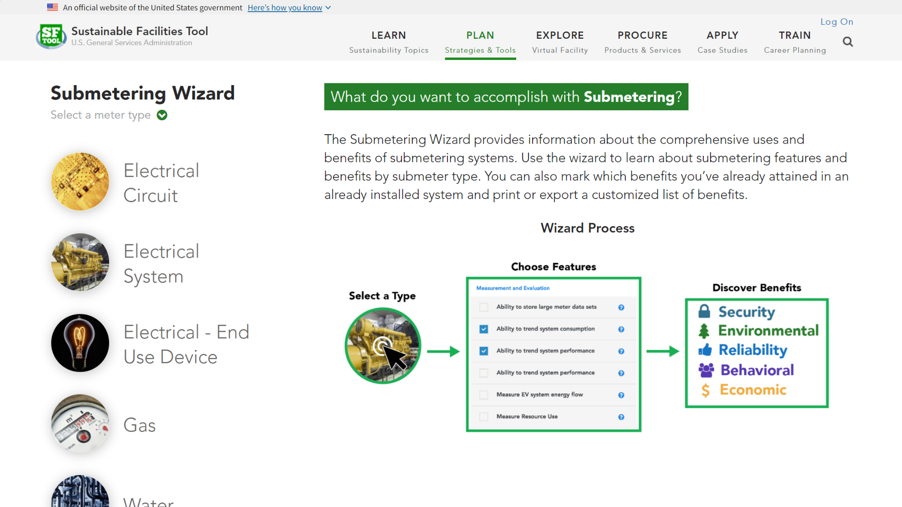
Notes:
One of the more interactive planning tools is the Submetering Wizard, which can help you learn about the features and benefits of each type of submeter.

Slide 24
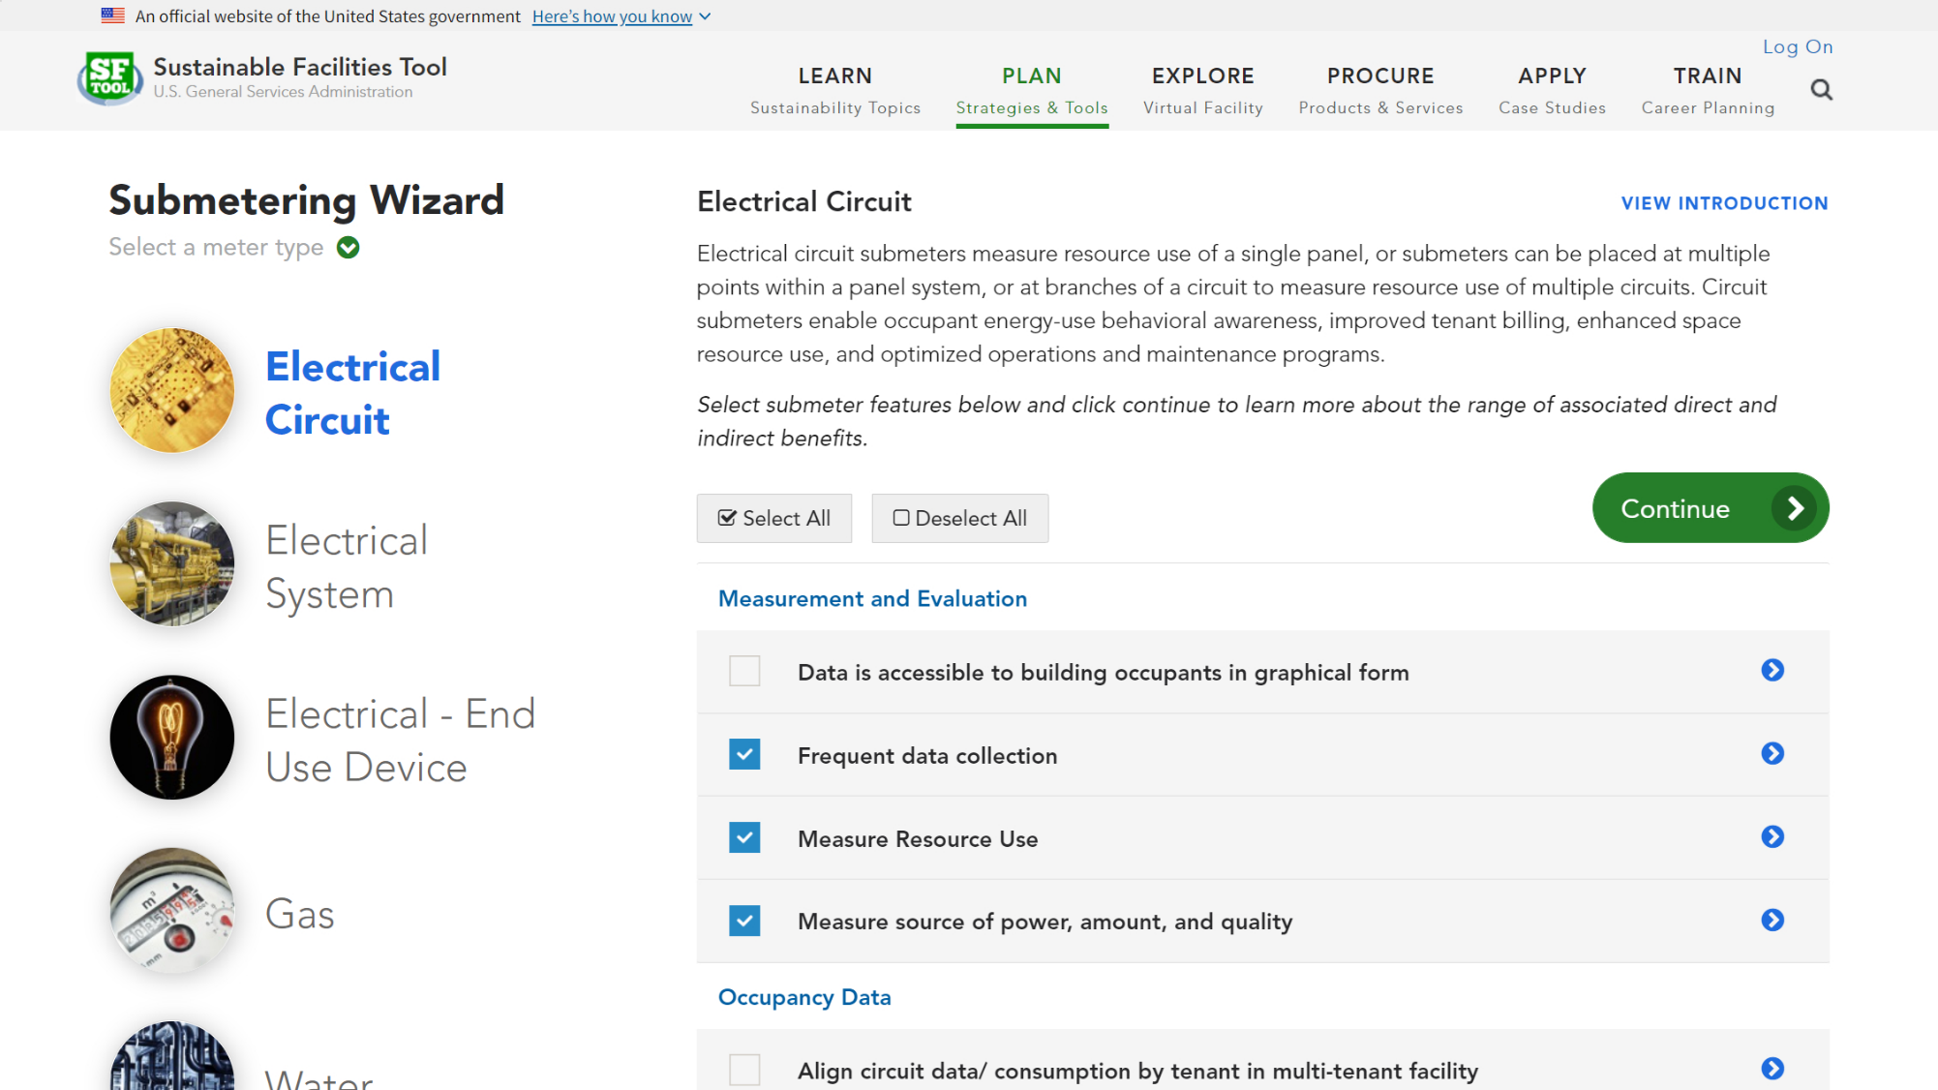
Notes:
Simply select a meter type, then choose the features you are interested in.

Slide 25
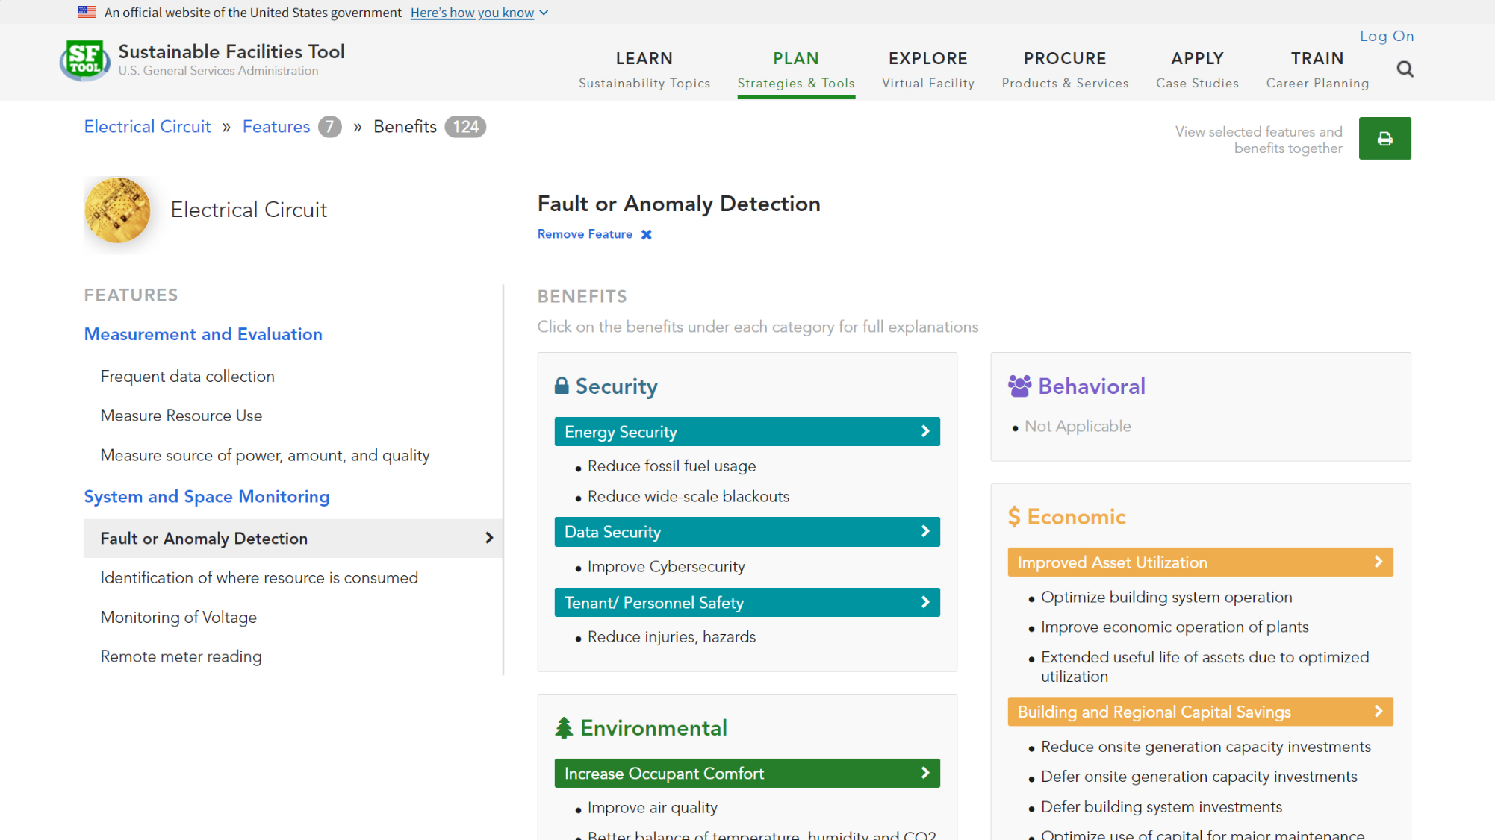
Notes:
You can then explore various benefits associated with each feature. Clicking on one will bring up a popup…

Slide 26
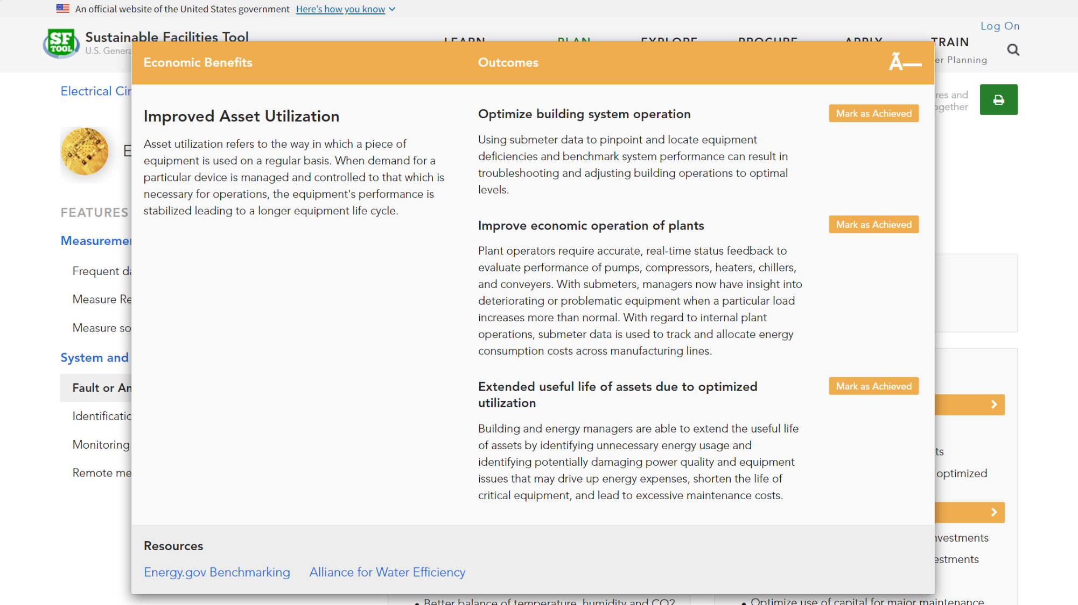
Notes:
Which displays the specific outcomes and resource links. You can mark the outcomes you’ve achieved in order to print out a checklist.

Slide 27
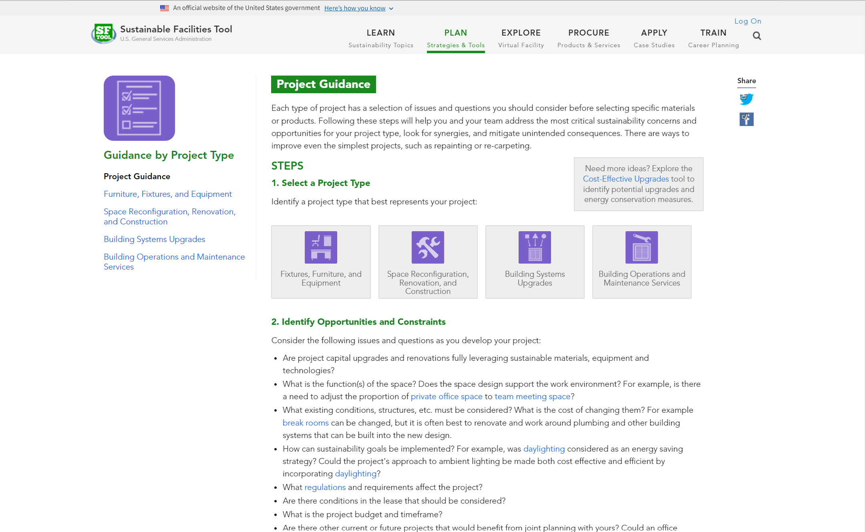
Notes:
The Plan section also includes guidance for specific project types.

Slide 28
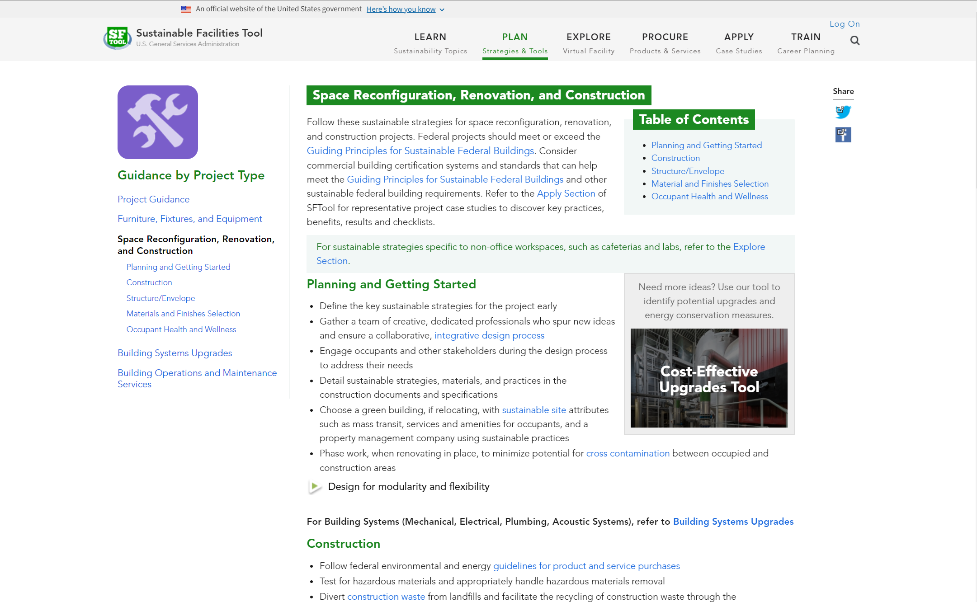
Notes:
For example, the Space Reconfiguration, Renovation, and Construction project type allows PMs to see a “brain dump” of considerations and requirements associated with specific aspects of a project (for example, Materials and Finishes Selection).

Slide 29
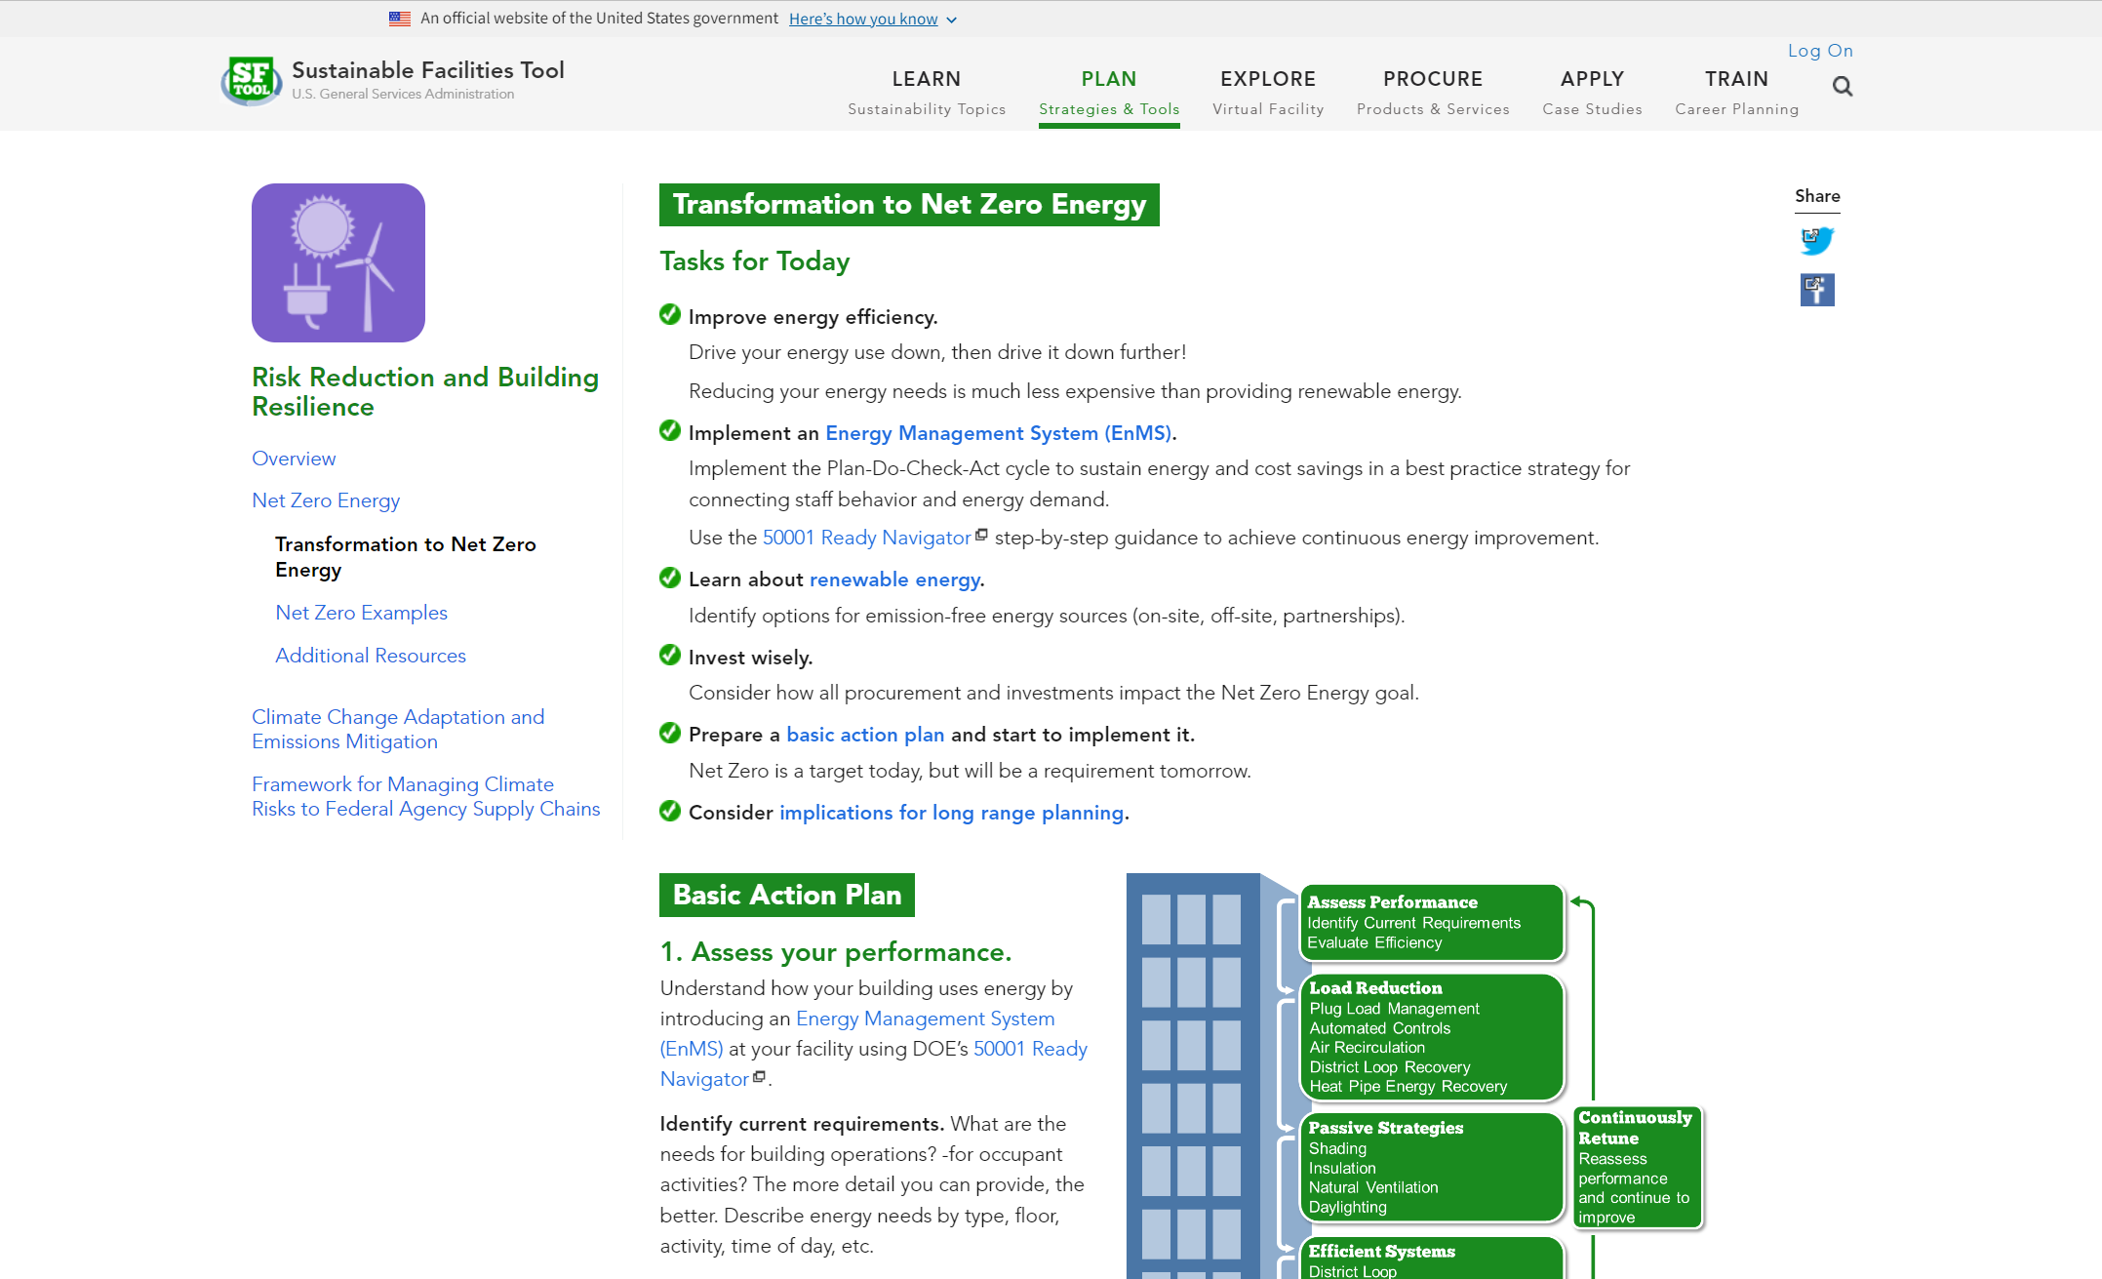
Notes:
The Plan section can also help you with long-term projects by translating complex topics into action plans.

Slide 30
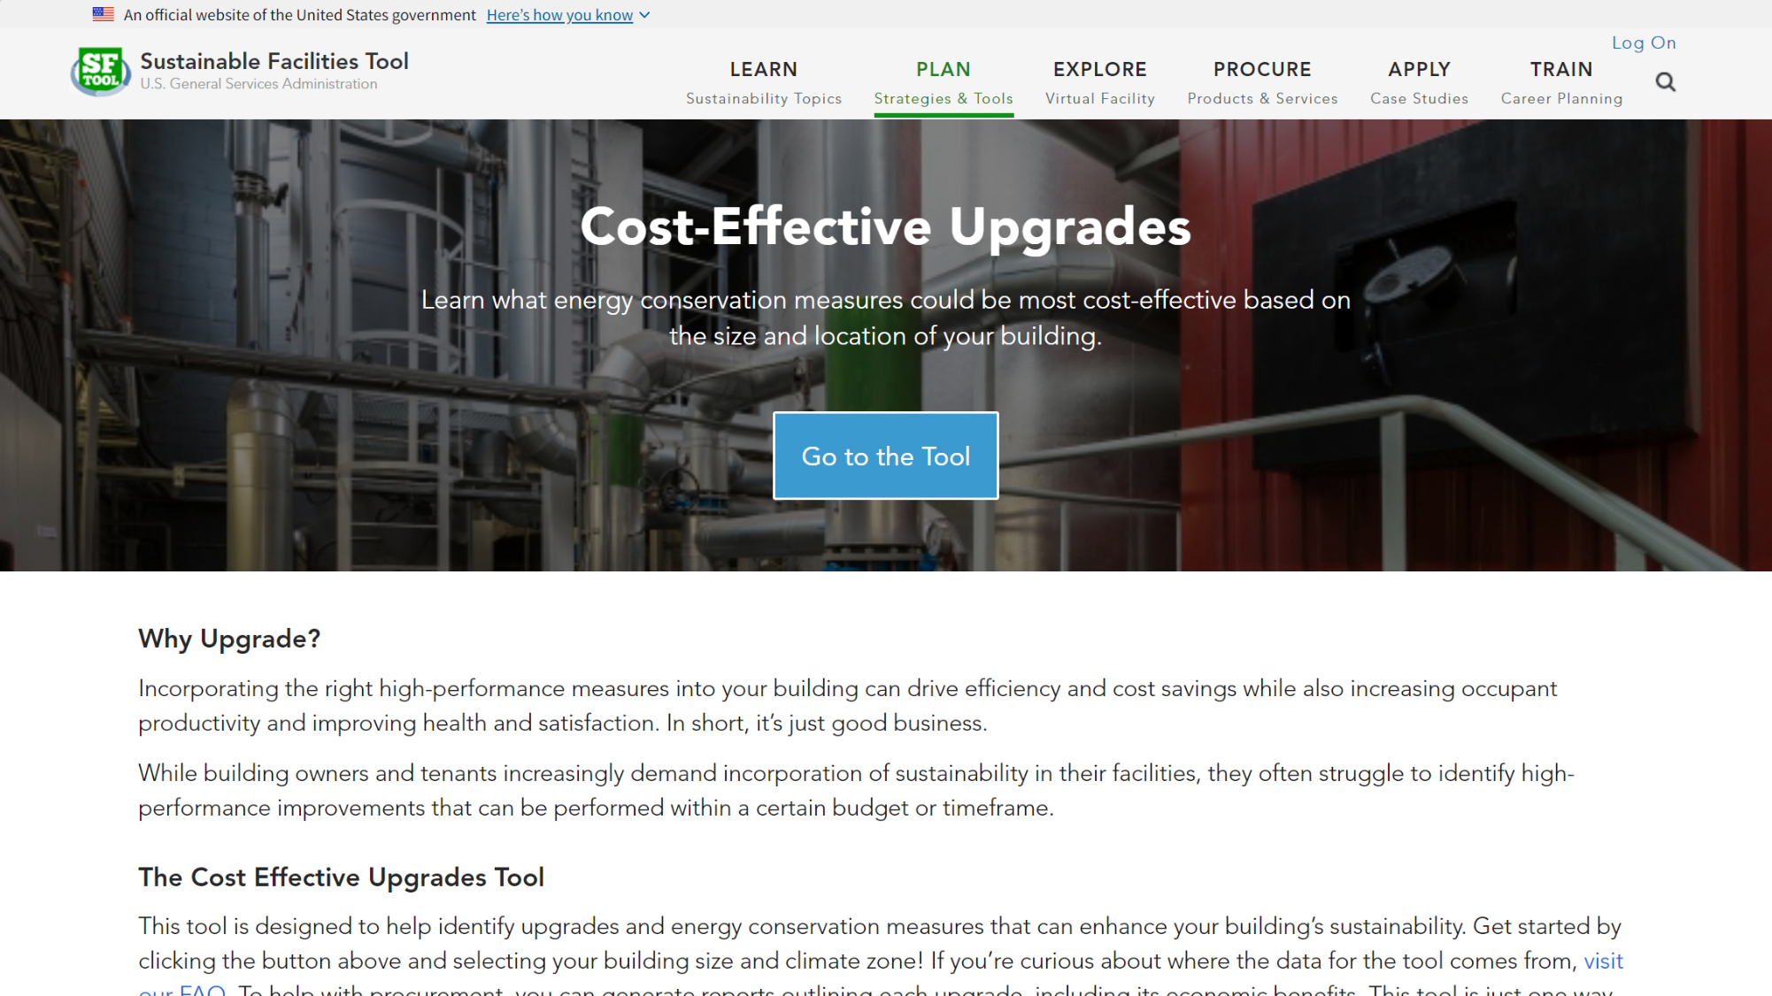
Notes:
You can also use the Cost-Effective Upgrades Tool to identify potential high-performance improvements.

Slide 31
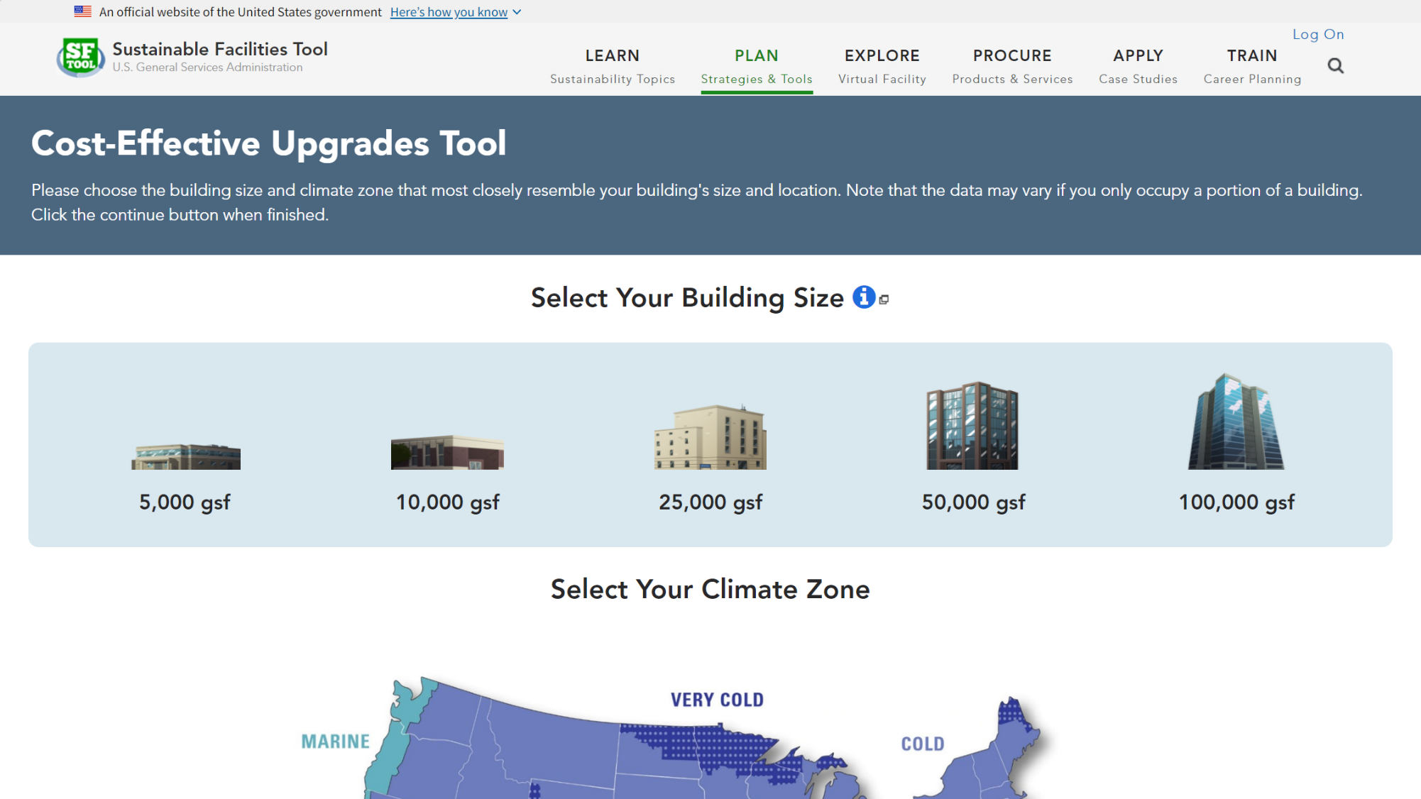
Notes:
Frist, select your building’s size and climate zone.

Slide 32
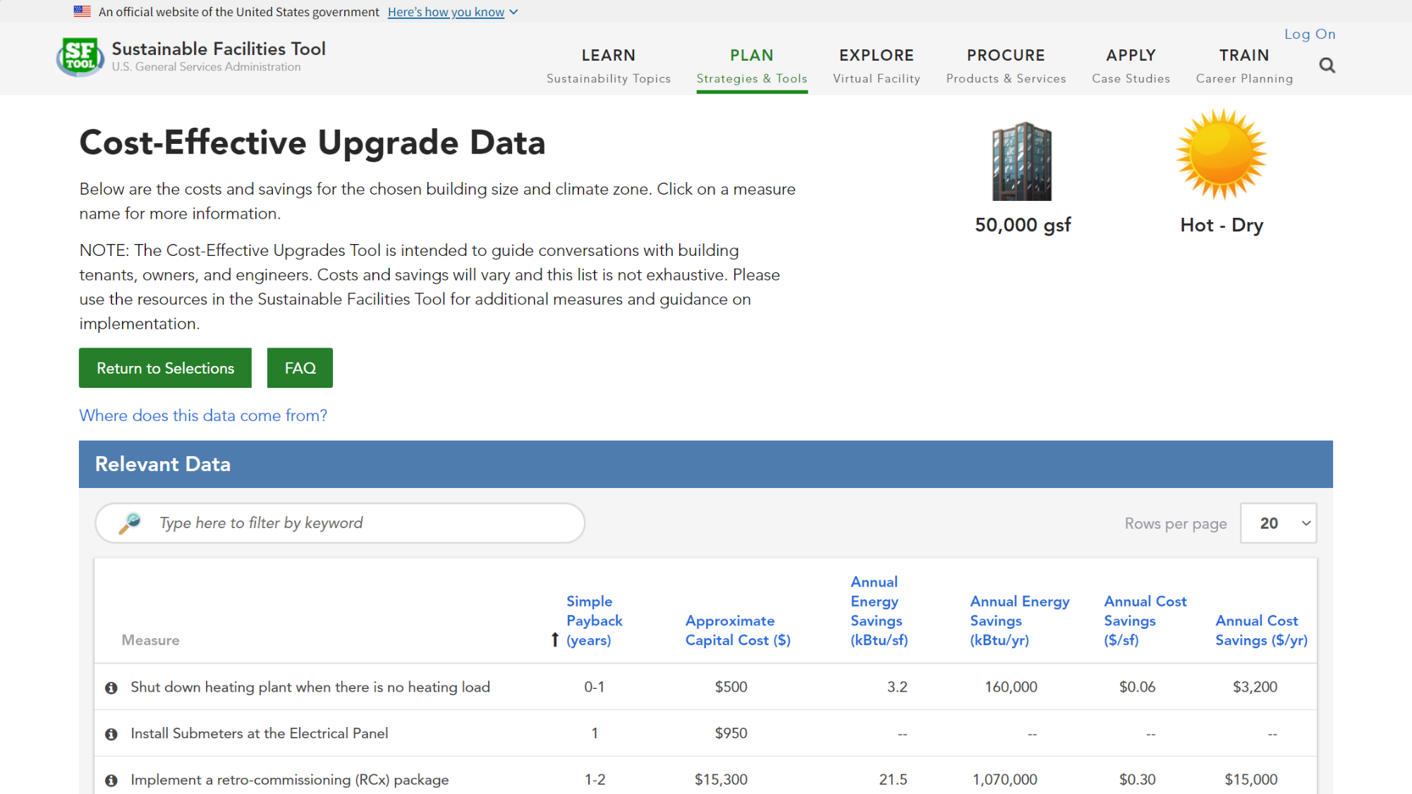
Notes:
Then explore measures that may be cost-effective for your building.

Slide 33
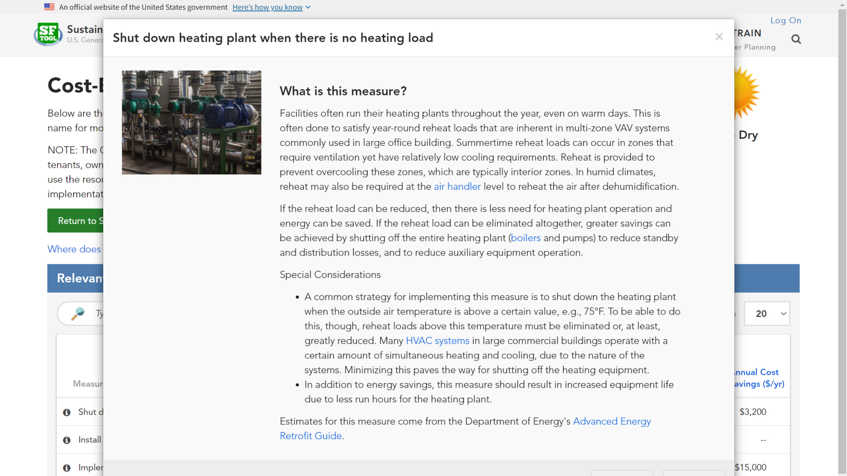
Notes:
Each measure includes a description and tips, as well as links to more information.

Slide 34
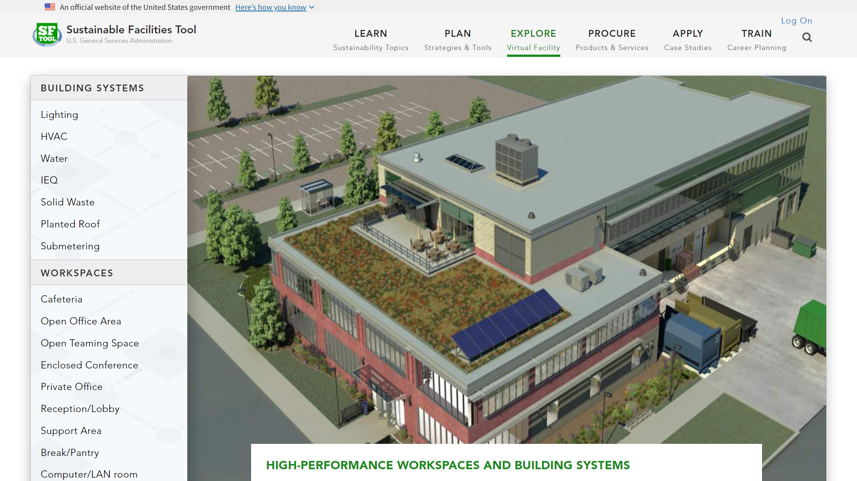
Notes:
In the Explore section, roam around a virtual building to compare materials and design strategies.

Slide 35
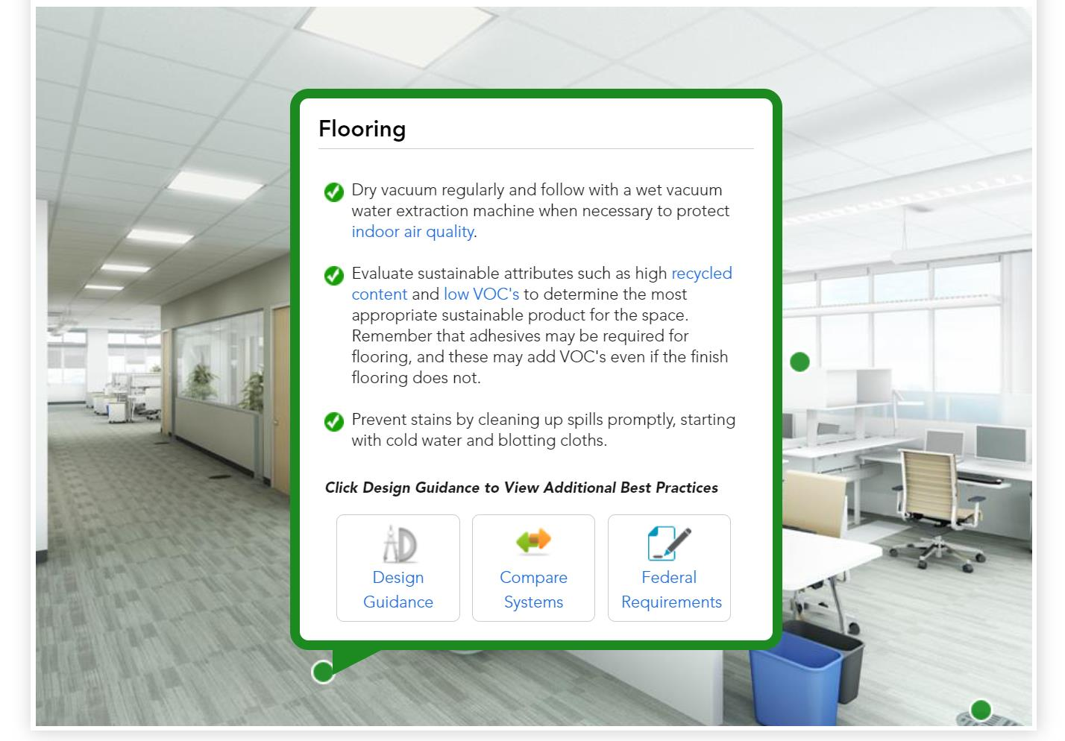
Notes:
Click on the green dots to learn more about each material.

Slide 36
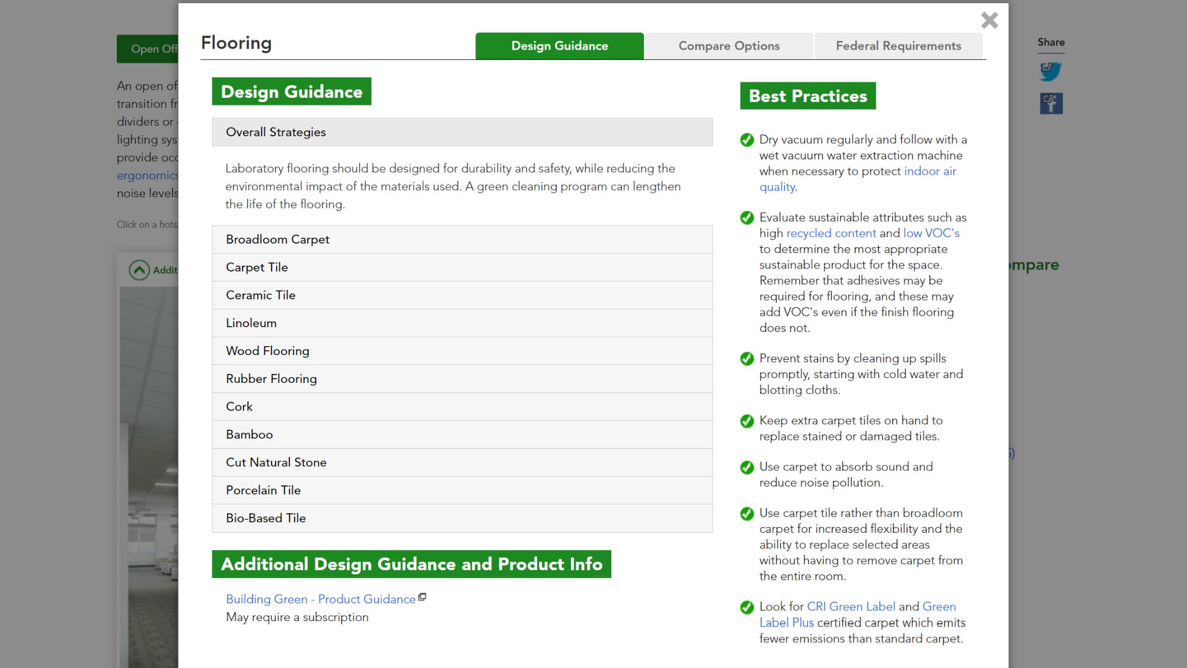
Notes:
Each material includes design guidance….

Slide 37
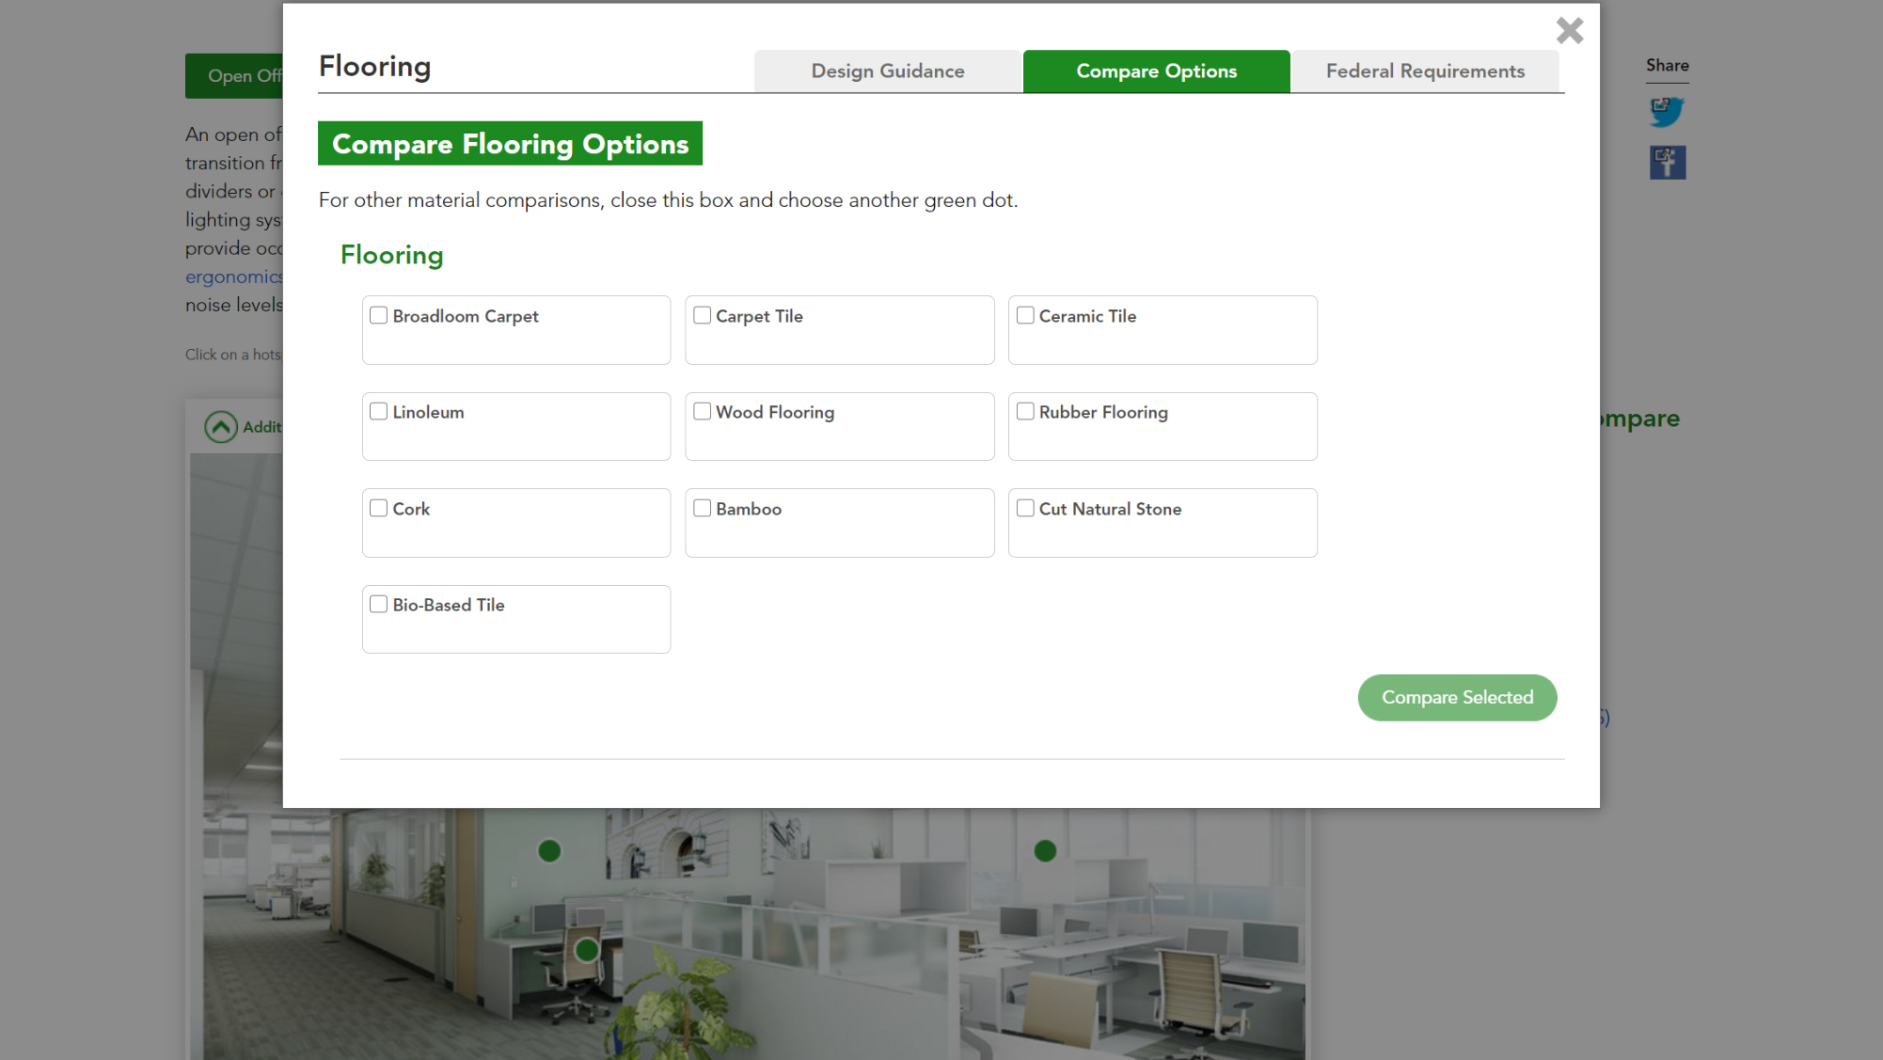
Notes:
…the ability to compare options across a wide variety of factors, such as life cycle cost and impact on indoor air quality…

Slide 38
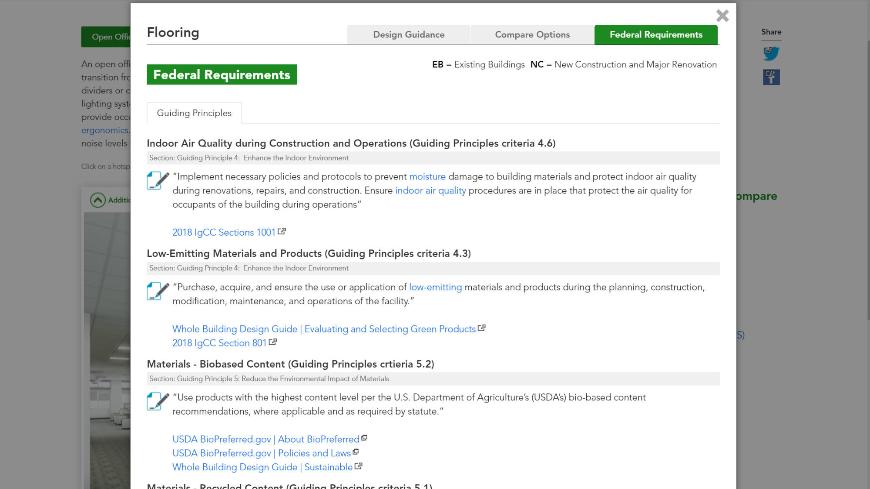
Notes:
…and related federal requirements.

Slide 39
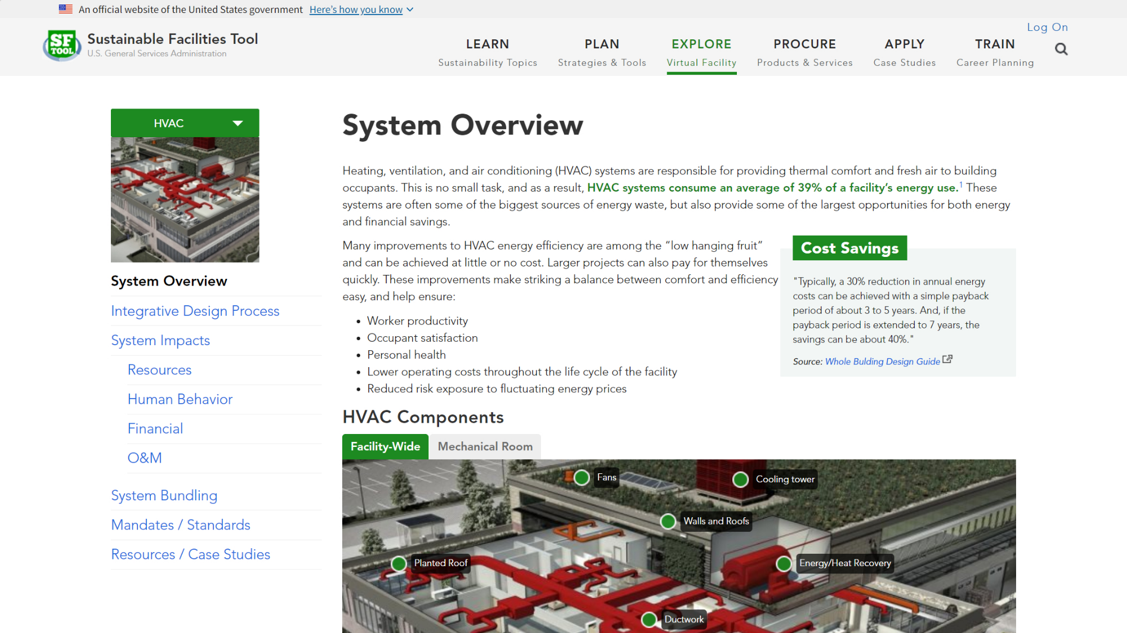
Notes:
You can also explore building systems, such as HVAC, lighting, and water, which highlight interactions between building systems and the people they serve.

Slide 40
Notes:
For each system, you can see how your role helps a team reduce costs and increase environmental sustainability.

Slide 41
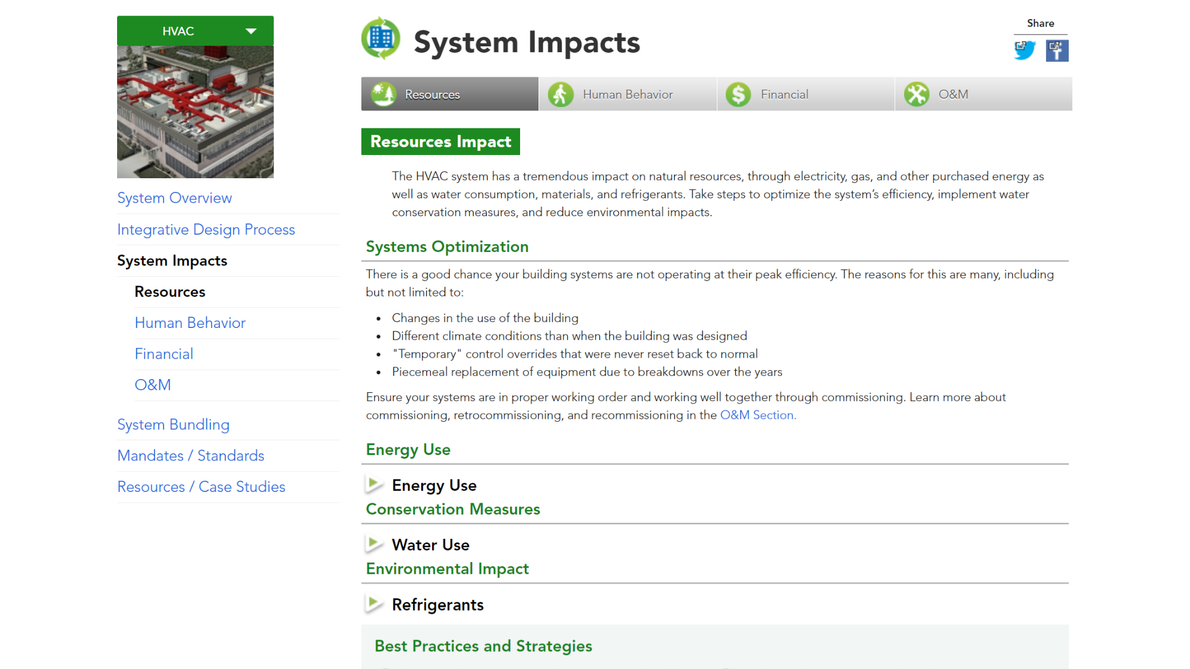
Notes:
You can also explore a system’s various impacts. We start with resources. HVAC systems have a significant impact on the building's overall energy and water use. Take into consideration these impacts to optimize your building performance.

Slide 42
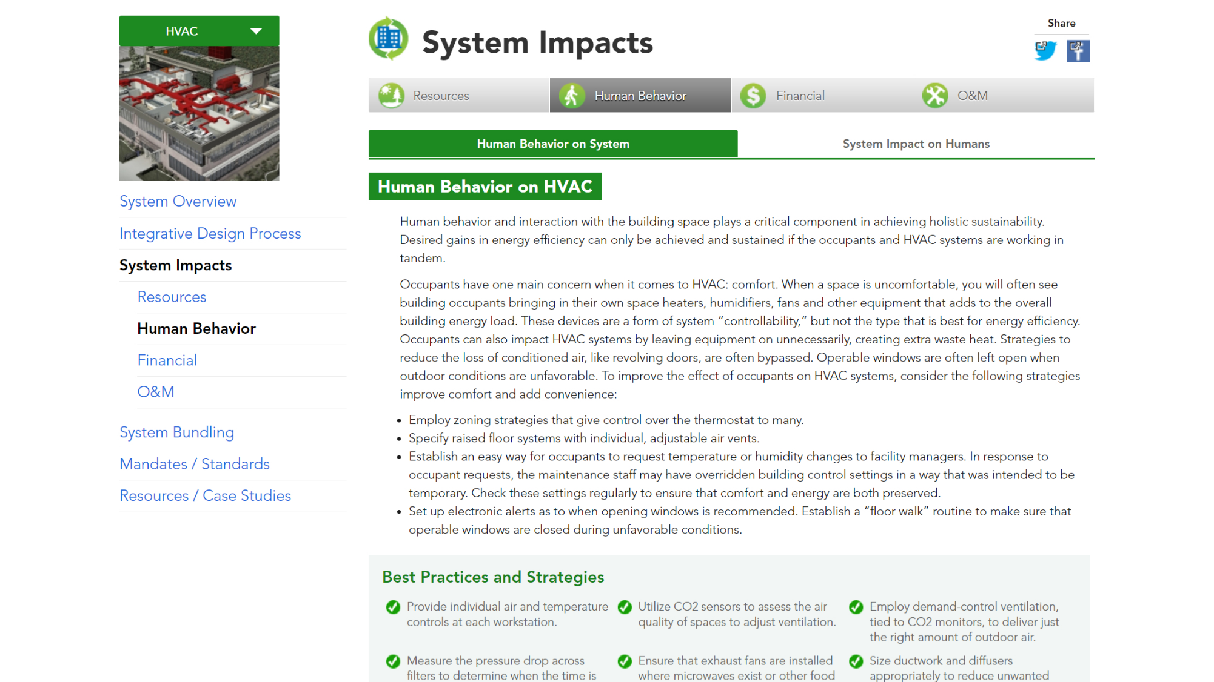
Notes:
HVAC systems also have an impact on the people in the building. And just as importantly, human behavior has an impact on system operation.

Slide 43
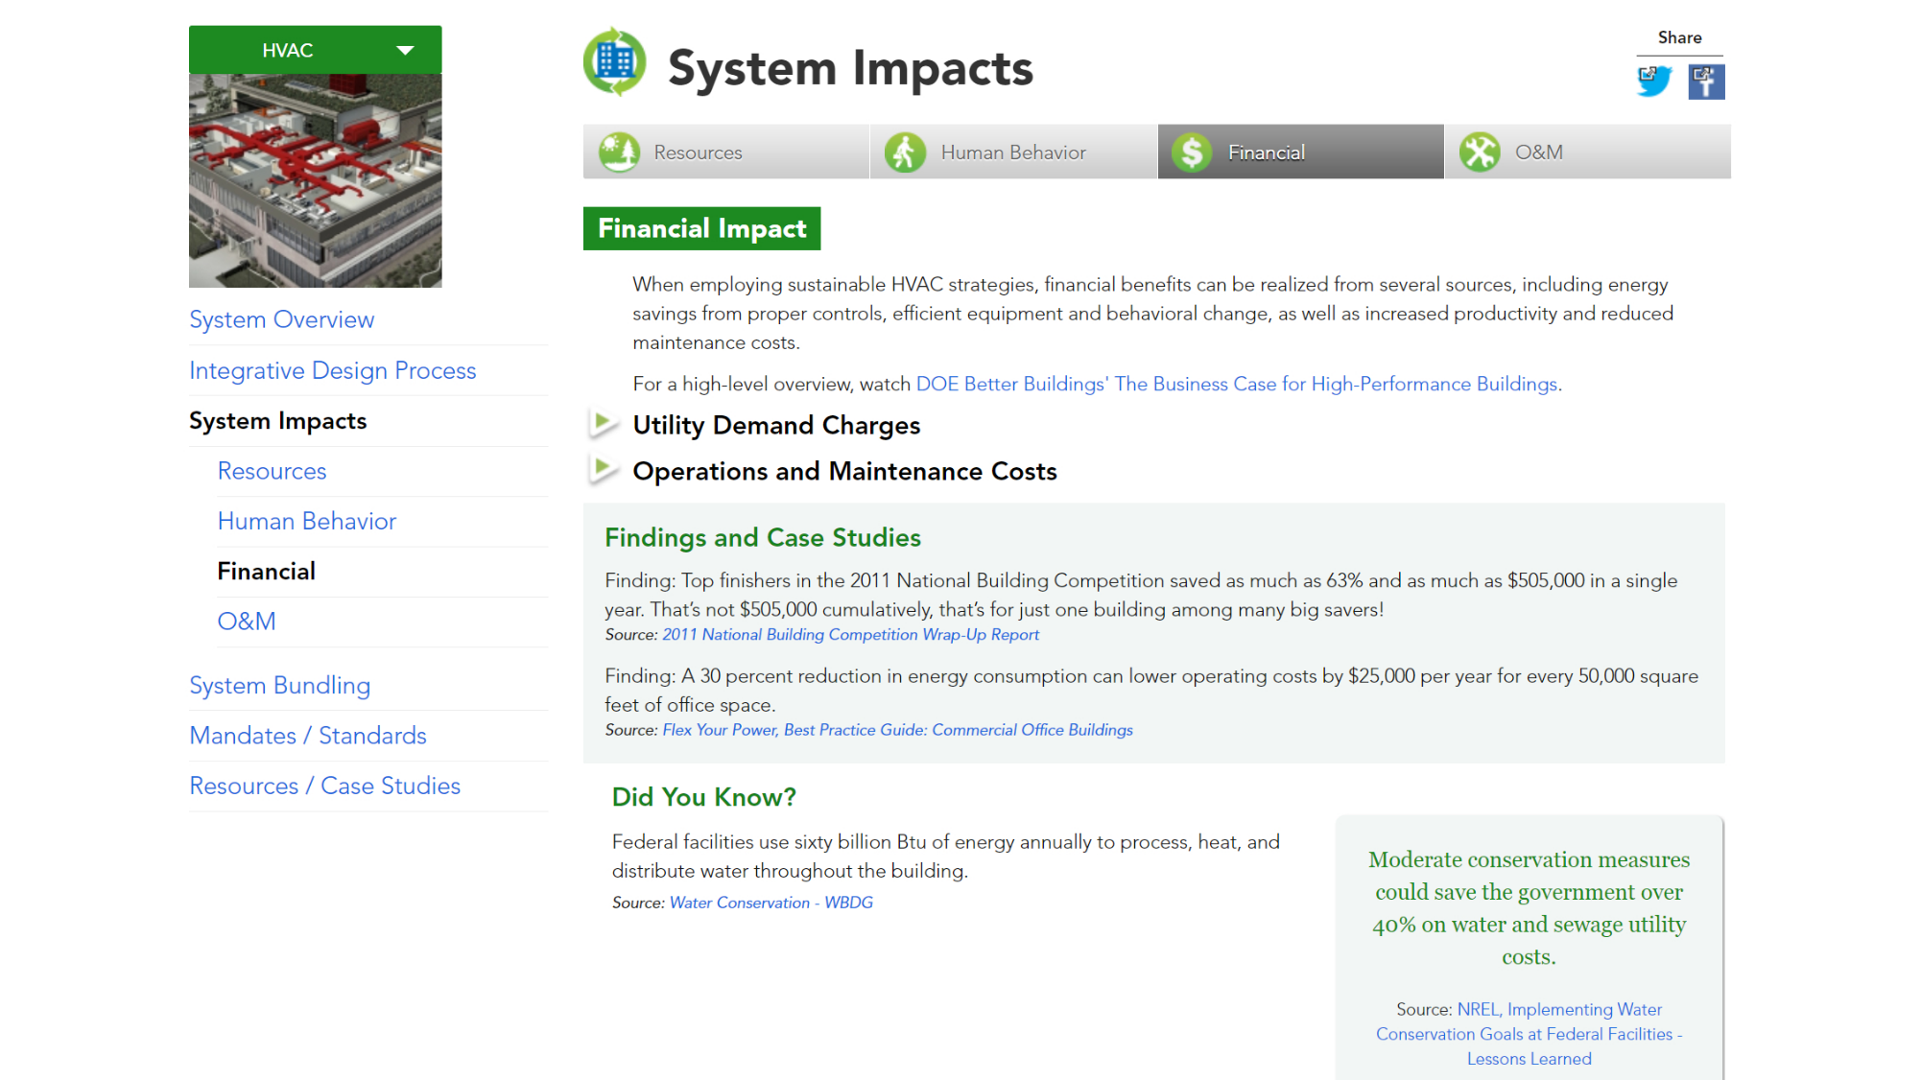
Notes:
Each system also has financial impacts. This section includes how high-performance improvements could help lower costs.

Slide 44
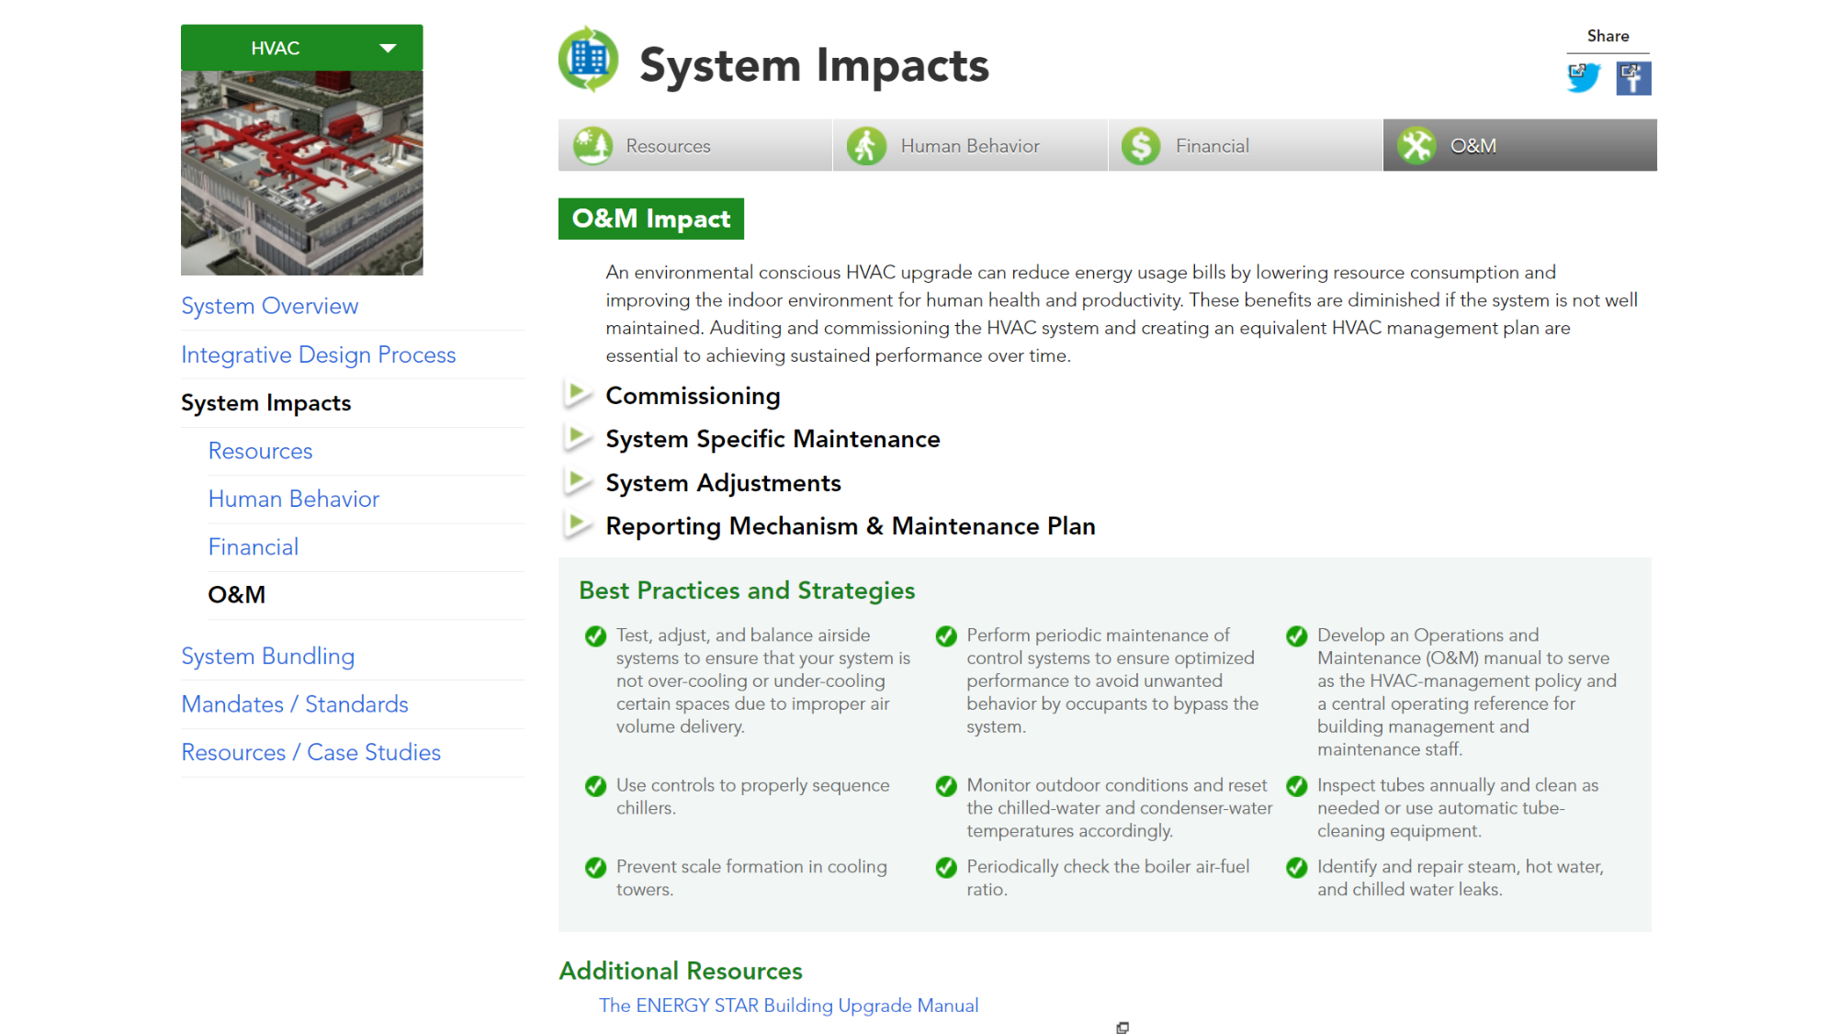
Notes:
You can also explore the system’s impact on operations and maintenance activities.

Slide 45
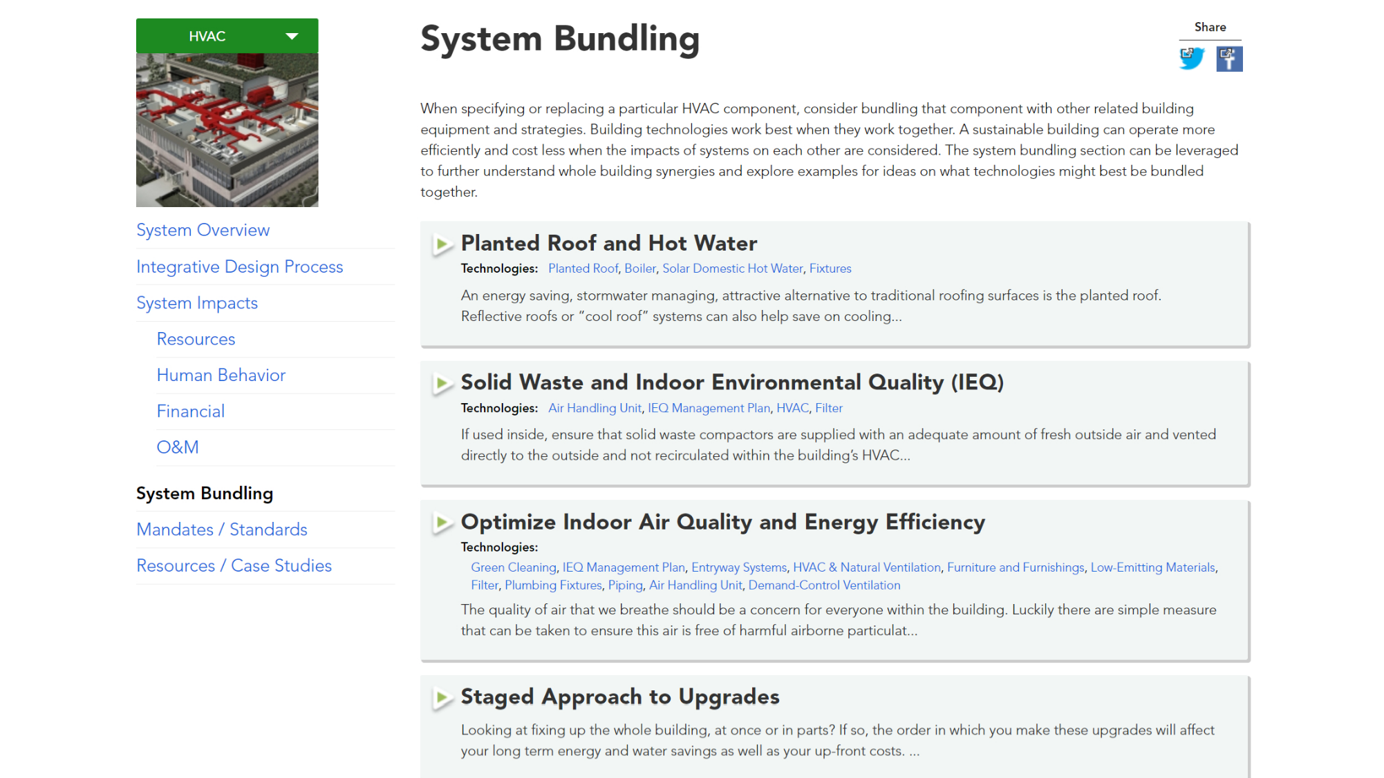
Notes:
When considering an HVAC renovation project, consider bundling components together to create strategies that deliver the largest beneficial impacts and greatest return on investment. The system bundling section can be leveraged to further understand whole building synergies and explore examples for ideas on what technologies might best be bundled together.

Slide 46
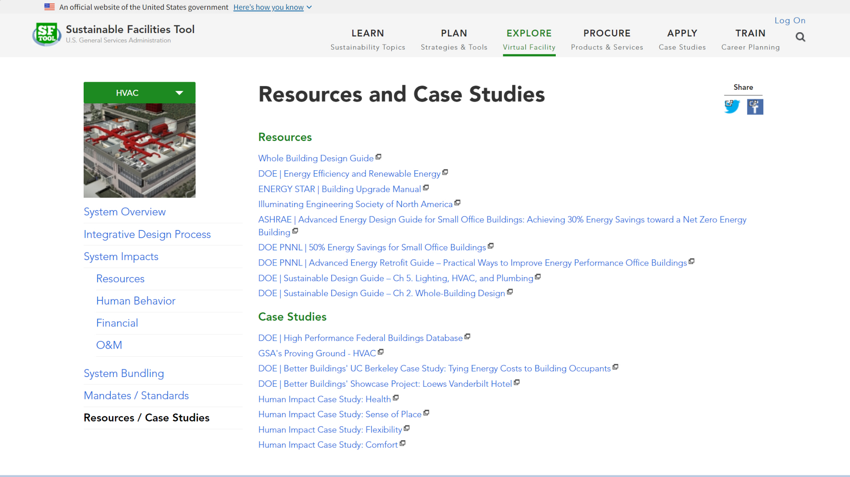
Notes:
Finally, each building system includes a section of further resources and case studies.

Slide 47
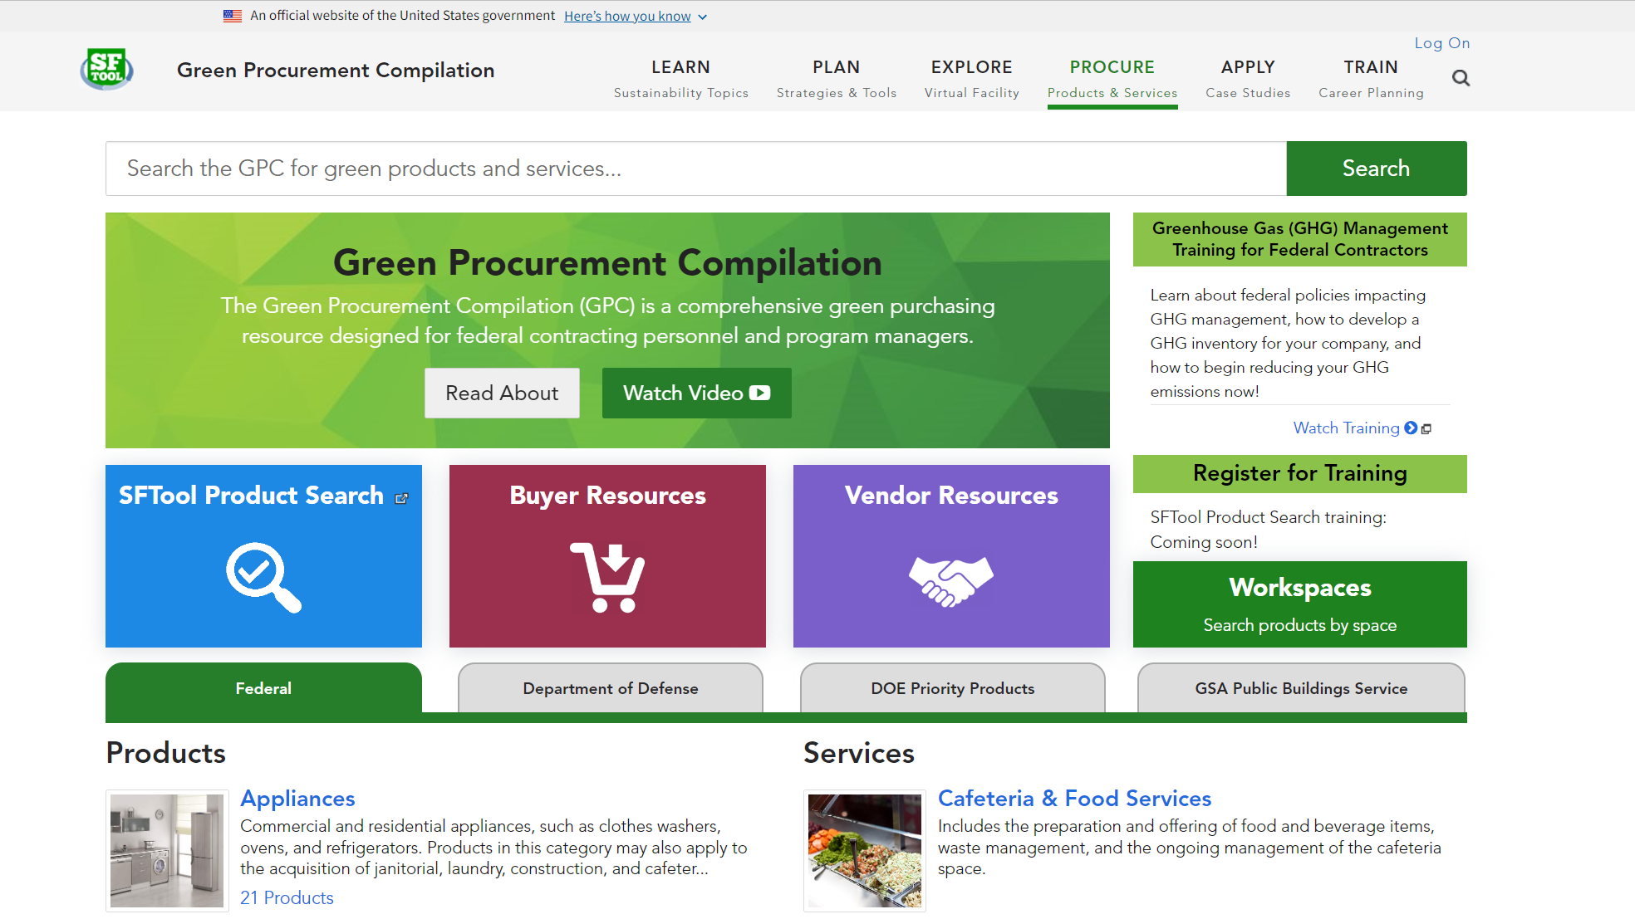
Notes:
The Procure section is the home of the Green Procurement Compilation, or GPC. Use GPC to find out what sustainability criteria to seek across hundreds of products and services.

Slide 48
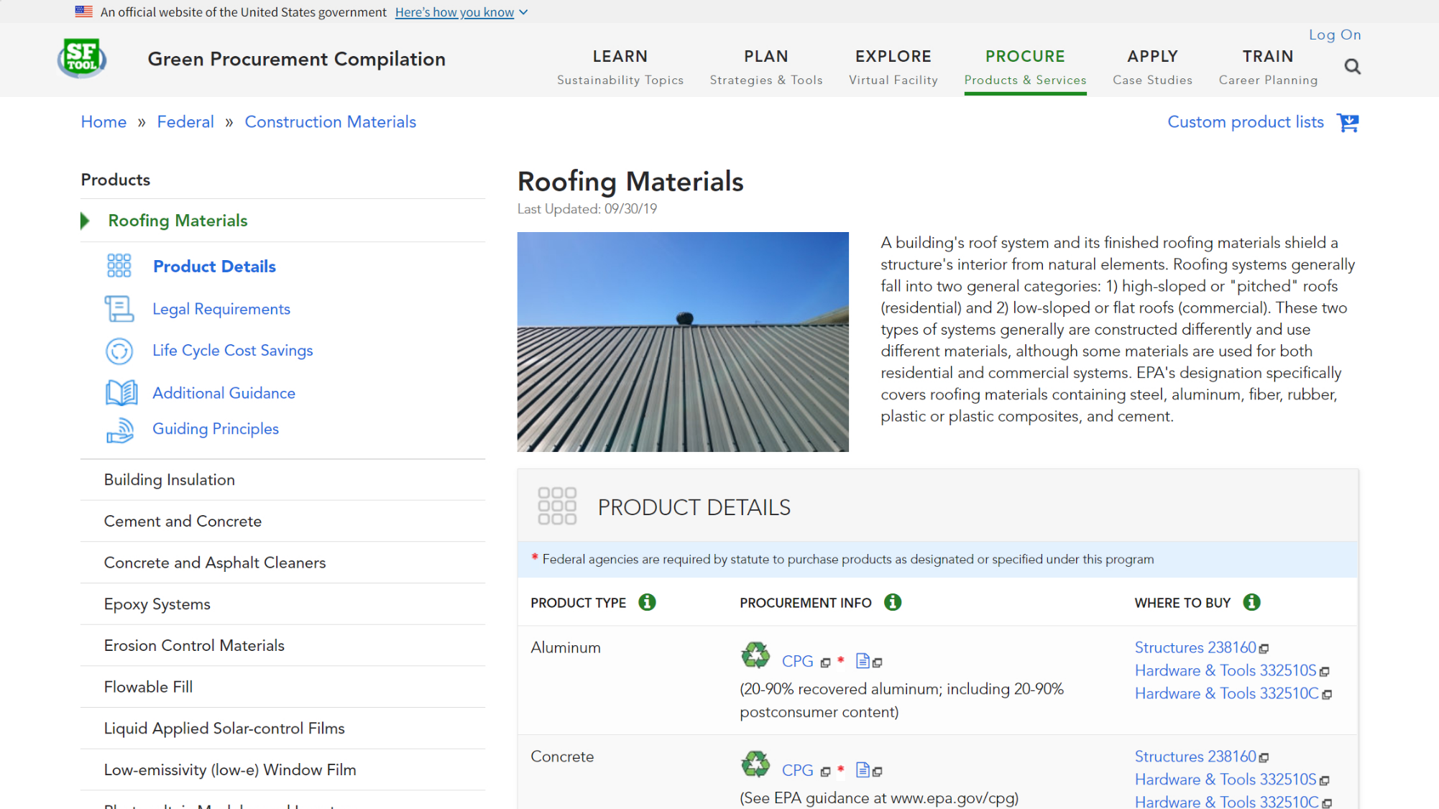
Notes:
Each product includes detailed procurement information, such as where to buy, appropriate FAR clauses, and life cycle cost savings.

Slide 49
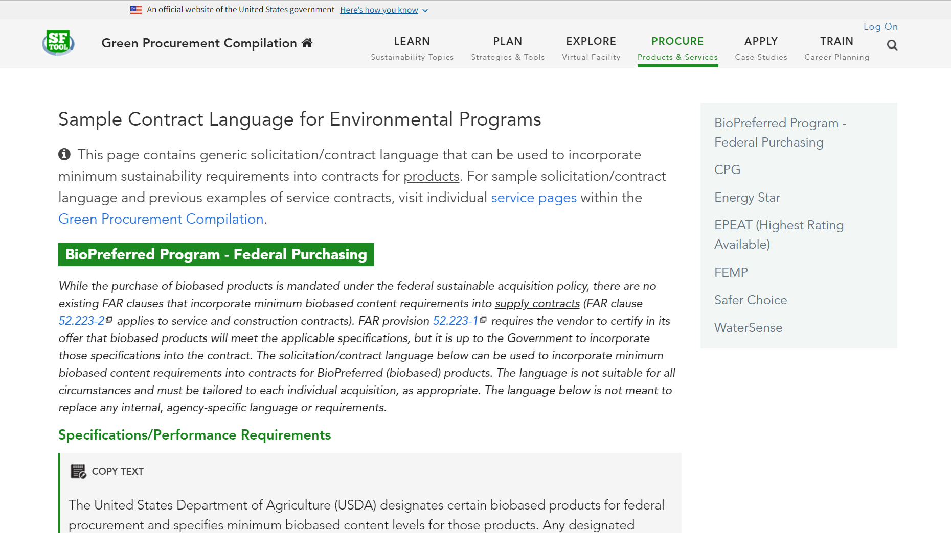
Notes:
From the Procurement Information under Product Details, you can also view sample contract language for required environmental programs.

Slide 50
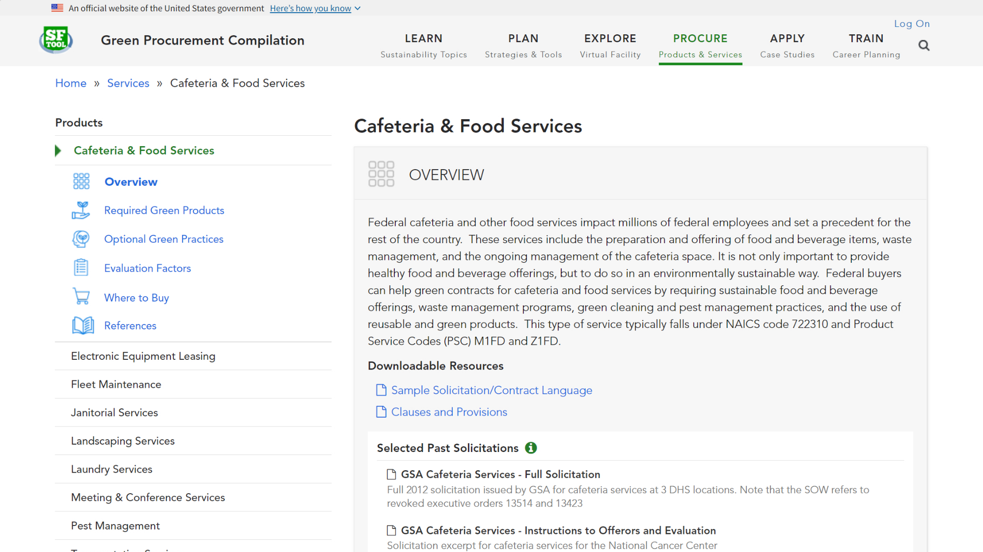
Notes:
Each service includes example past solicitations, required green products, optional green practices, sample evaluation factors, information on where to buy, and references.

Slide 51
Notes:
From the Procure section, you can navigate to SFTool Product Search, which simplifies environmentally responsible purchasing.

Slide 52
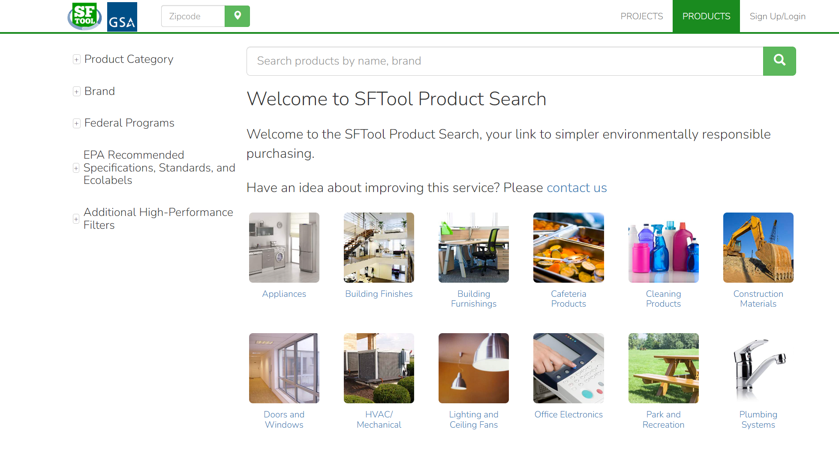
Notes:
With SFTool Product Search you can search over 150 categories and subcategories that represent over 5,700 brands and more than 300,000 products.

Slide 53
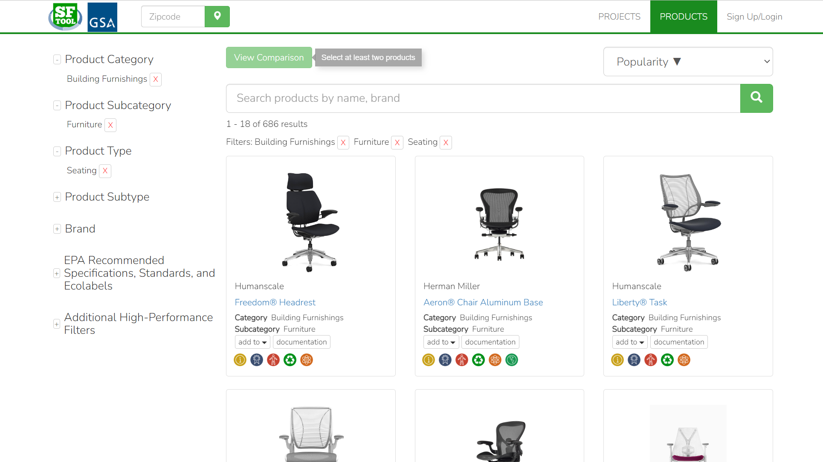
Notes:
Users can explore products by category, type, and brand as well as by certifications and performance specifications.

Slide 54
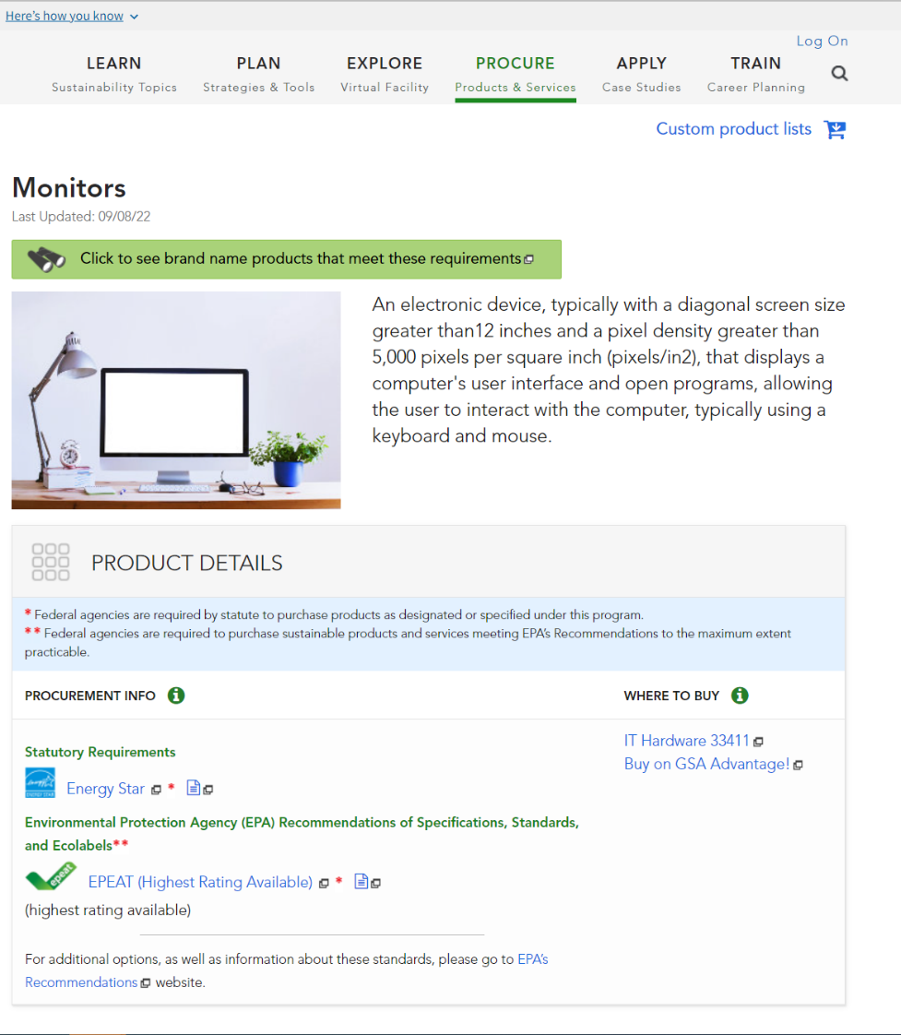
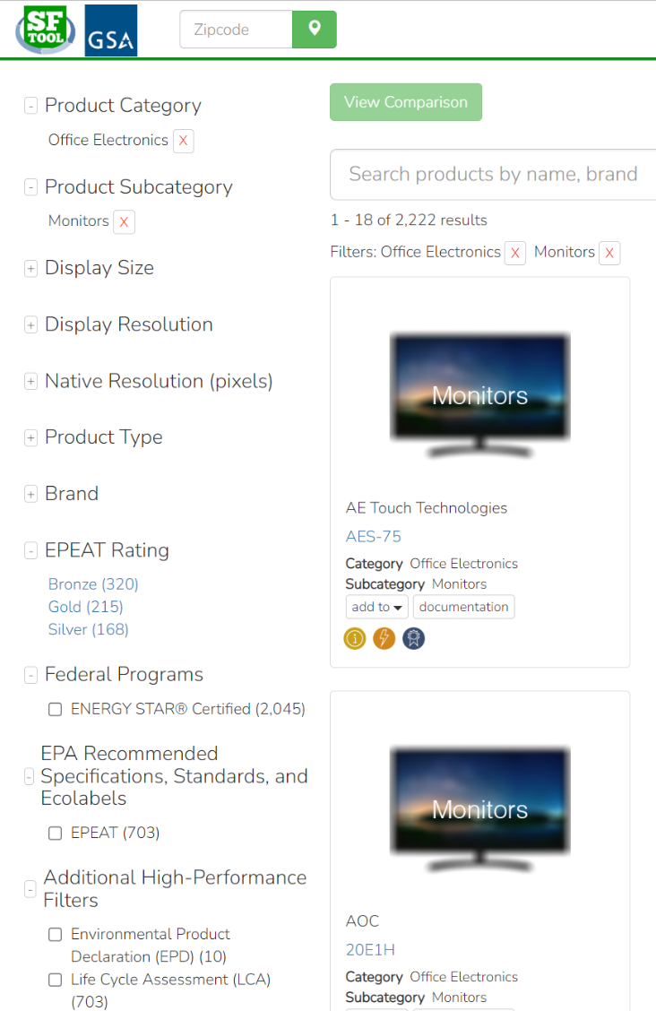
Notes:
All listed products align with the relevant Federal Environmental Program as covered by the Green Procurement Compilation (GPC) on SFTool.gov.

Slide 55
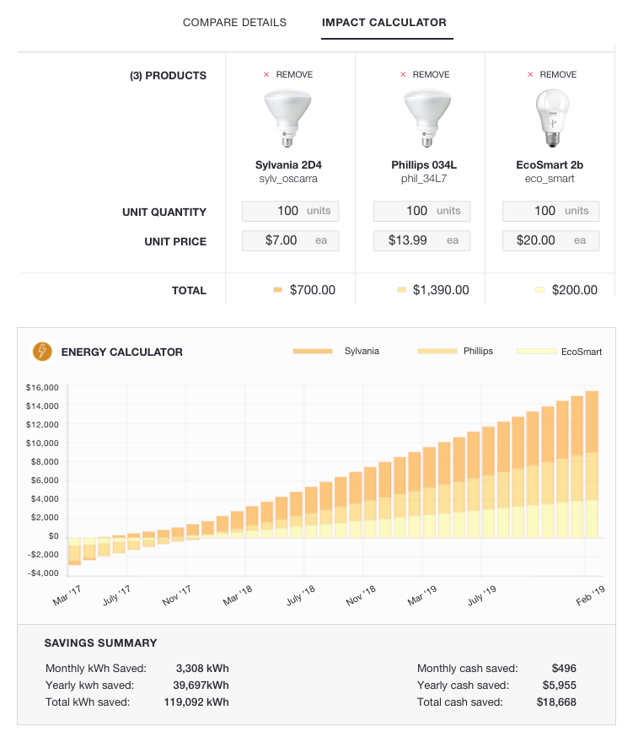
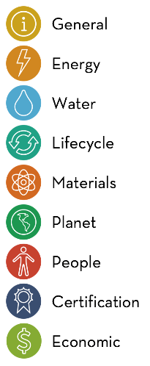
Notes:
Users can also compare products across a variety of subjects.

Slide 56
Notes:
Product Search can compile procurement compliance documentation at the project level. It allows users to save all their procurement documentation so that as changes arise, they can easily modify their project specific data.

Slide 57
Notes:
From the Procure section, you can also navigate to Buyer Resources…

Slide 58
Notes:
The Buyer Resources page includes an overview of what Federal government acquisition tools can be best utilized during each phase of the procurement life cycle, as well as training, policy/guidance, and other resources for Buyers.

Slide 59
Notes:
From the Procure section, you can also navigate to Vendor Resources…

Slide 60
Notes:
The Vendor Resources page provides vendors with a single point-of-entry to learn more about sustainability and climate related Executive Orders, Federal Acquisition Regulations (FAR), environmental programs, training, Frequently Asked Questions, and more.

Slide 61
Notes:
Returning to the main portion of SFTool, you can use the Apply section to explore agency resources from the Interagency Sustainability Working Group, read case studies, and sign up for Federal newsletters.

Slide 62
Notes:
Under SFTool’s Train section, you will find the Facilities Management Institute. This is your primary source for complying with the Federal Buildings Personnel Training Act (or FBPTA). The box in the lower left will take you to AccelerateFM. AccelerateFM is not part of SFTool, but it’s the federal government’s main tool for managing the professional development of federal buildings personnel. The box in the upper right will take you to FEDSAT, which stands for the Federal Facilities Skills Assessment Tool, and which is part of SFTool….

Slide 63
Notes:
You can use this tool to assess your knowledge of building management. The assessment can help you identify areas where you might need additional training and locate free resources to fill the gaps. It takes about 4 hours to complete, but it can be much less if your existing credentials give you partial credit.
You can watch a short video introduction to FBPTA and FEDSAT by clicking the yellow circle…

Slide 64
Notes:
Click to play video in a browser window.

Slide 65
Notes:
The second tab on the FEDSAT homepage will provide you with a link to Accelerate FM. While the third tab will link you to resources to earn free continuing education credits….

Slide 66
Notes:
The free credits have been approved for a variety of certifications and may also qualify as “self-study” credits for other credentials. The listing includes 1 hour of credit for taking FEDSAT, as well as credits offered by other federal sources, such as the Whole Building Design Guide and Federal Energy Management Program.

Slide 67
Notes:
Back on the FEDSAT homepage, the fourth tab links to a list of resources that can help you learn more about all the topics covered in FEDSAT.
If you’re interested in taking the FEDSAT assessment, simply go to the first tab and log in or register. It’s open to the public, but there are some additional options for government users.

Slide 68
Notes:
Government users are encouraged to sign in with Google if their agency supports it. Otherwise, you can create a local SFTool account.

Slide 69
Notes:
Once logged in, click ‘START FEDSAT’…

Slide 70
Notes:
This will take you to the FEDSAT dashboard, where you can track your progress. If you have any questions about taking the assessment, check out the User Guide.
If you are a government user with an Accelerate FM account, get started by clicking the “Earn Credit” button to pass out of portions of FEDSAT based on your credentials.

Slide 71
Notes:
The earn credit button will take you to a form to link your account with Accelerate FM. Just enter the email address you used on Accelerate FM, confirm it, and click to link the account. Then go back to the dashboard.

Slide 72
Notes:
On the dashboard, you’ll see how much of the assessment your credentials have fulfilled. Get started on the rest by clicking the “Take Assessment” button.

Slide 73
Notes:
You will now see the assessment listing screen. The credits you earned by linking with Accelerate FM will appear as the smaller circle on each card, while your overall progress on the section appears in the main circle. From this screen, you can also explore learning resources by section. To continue the assessment, click the “continue” or “start” button at the bottom right of each card.

Slide 74
Notes:
The assessment consists of a series of multiple choice questions. If you don’t know the answer, you can click the help button in the upper right of each question to read more about the topic.

Slide 75
Notes:
Once you finish a section, you’ll see your score. You need to answer 70% correct to pass, but you can retry the questions you missed as many times as you need. On this screen, you’ll also see the learning resources related to the questions you missed.

Slide 76
Notes:
When you’ve completed the assessment, return to the dashboard to claim your certificate. If you linked your account to Accelerate FM, it will automatically update to reflect your completion.

Slide 77
Notes:
Finally, if you’re building your own app, your developers can use the SFTool API to access content directly. Just look for the “Developer” link in the footer of every page.

Slide 78
Notes:
Sign up for the SFTool Newsletter and follow SFTool on Social Media!
Newsletter: https://sftool.gov/home/contact
LinkedIn: https://www.linkedin.com/company/sftool/
Facebook: https://www.facebook.com/SFTool/
Twitter: https://twitter.com/sftool
Pinterest: https://www.pinterest.com/sftool/

Slide 79
Contact
https://sftool.gov
sftool@gsa.gov
Social Security Support Center

